Slide 1

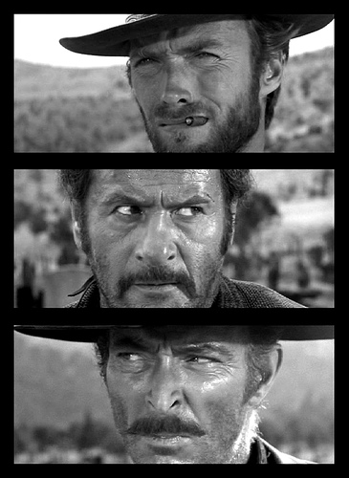
The Good, the Bad, and the Ugly
¹B. Lim, ¹H. Sung, ¹Y. Shin
²M. S. Bessell,
³R. Karimov, and ³M. Ibrahimov
¹ARCSEC, SJU, Korea
²RSAA, ANU, Australia
³UBAI, Uzbekistan

Slide 2
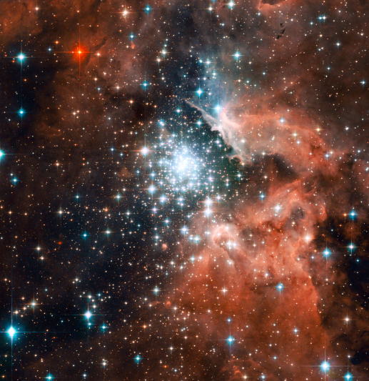
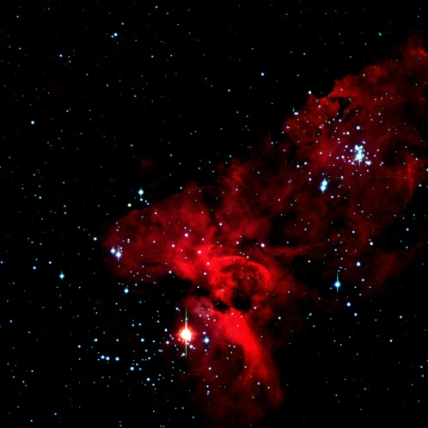
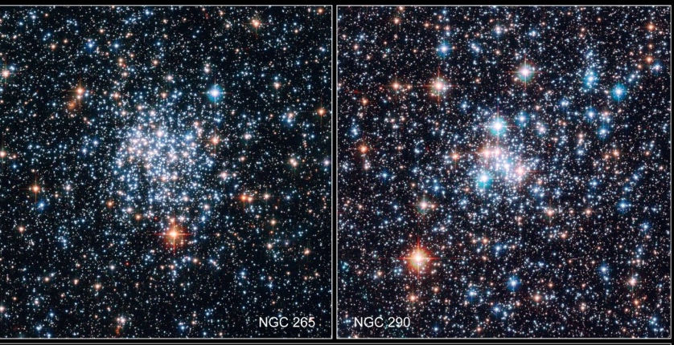
Open Clusters (OCs)?
A group of stars (Stellar systems)
The same origin
Almost same distance, age, chemical composition, kinematical properties, etc
Distribute in the disk of the Galaxy
The number of members
- Several 10~ 1000 stars

Slide 3
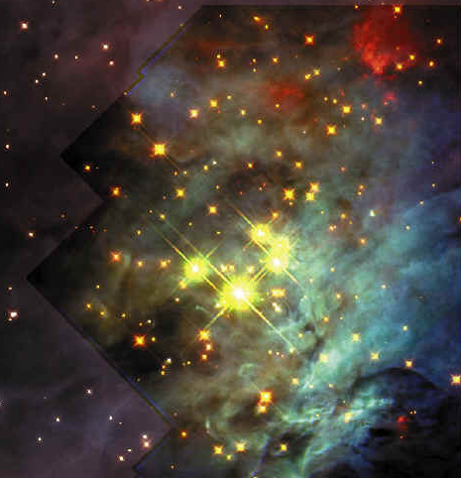
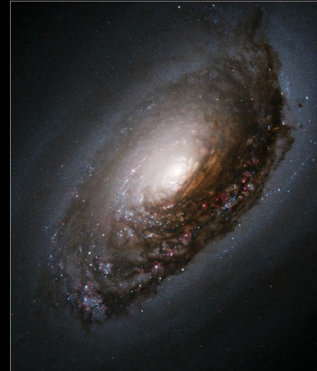
Why are open clusters important?
From the viewpoint of near-field cosmology
  Formation of the disks of the Galaxy
  Chemical evolution of the disks relating to the star formation history in the Galaxy
From the viewpoint of stellar astronomy
  Stellar evolution
  Stellar initial mass function
  Massive star formation
  Dynamical evolution

Slide 4
SOS (Sejong Open clusters Survey)
Main targets: Clusters in the northern hemisphere
Photometric analysis based on
  Lim et al. (2008): the characteristics of CCD system
  Lim et al. (2009): Standard transformation
The fundamental parameters of OCs
  Reddening, Distance, Size, Age, Stellar mass distribution (the initial mass function)
Importance of this project
  Providing very homogeneous photometric data ! ! !

Slide 5
How many data have we obtained?
For priority 0, 1

Slide 6
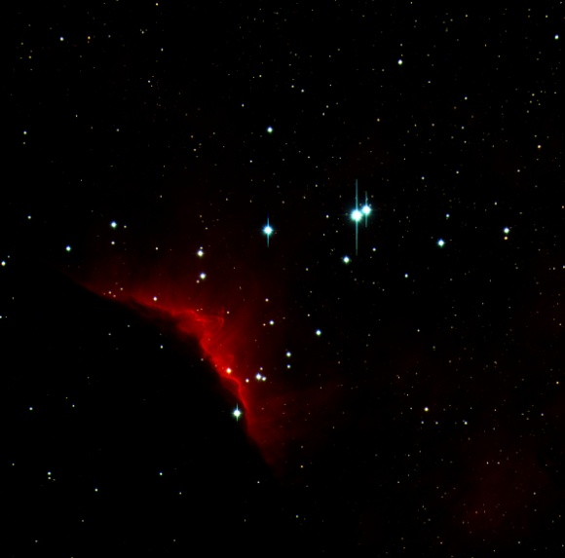
Some Results
Pismis Moreno 1

Slide 7

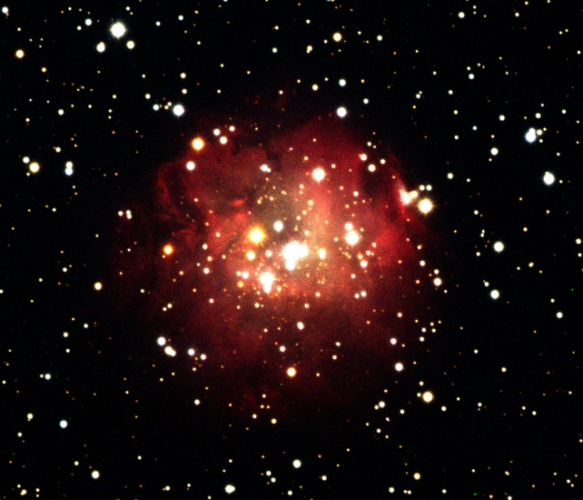
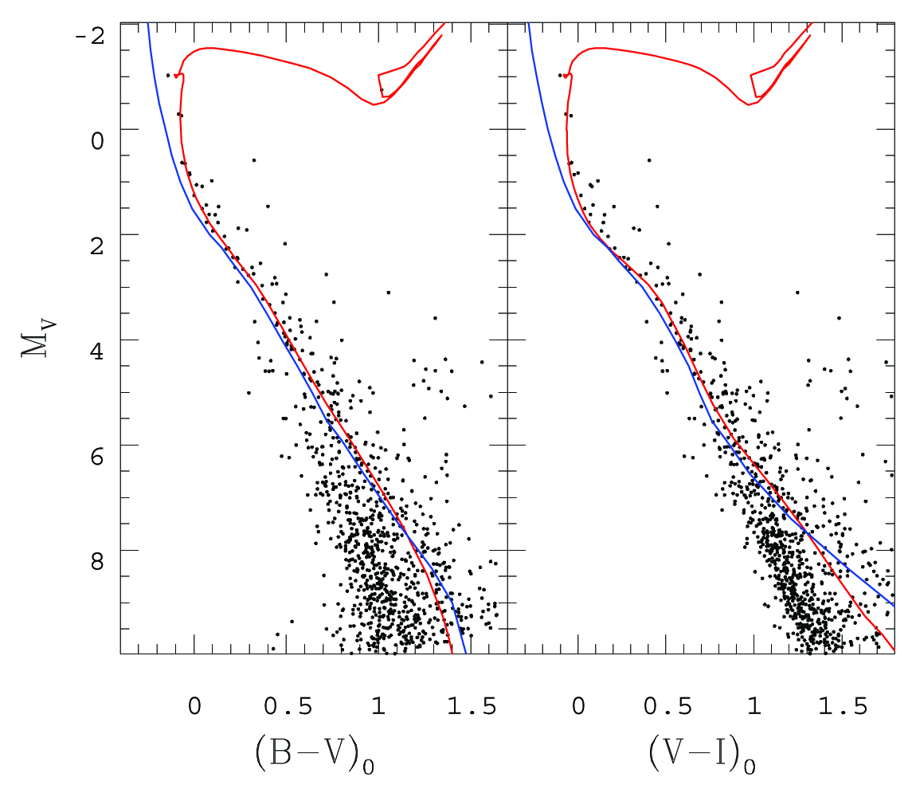
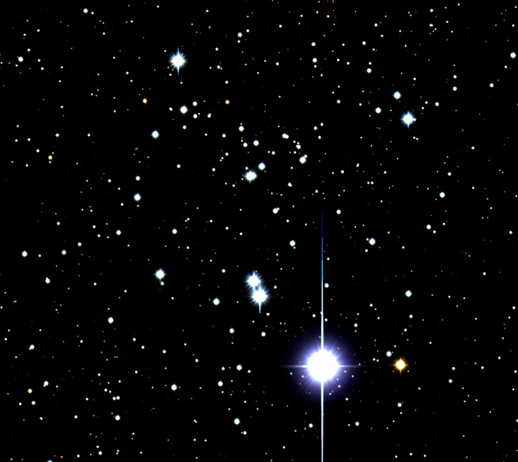
The Good
NGC 1624
<E(B-V )>=0.87±0.03
Distance ~ 5.5 kpc
Age (log t) ~ 6.70
NGC 2353
<E(B-V )>=0.10±0.04
Distance ~ 1.2 kpc
Age (log t) ~ 8.35
Young and intermediate age

Slide 8
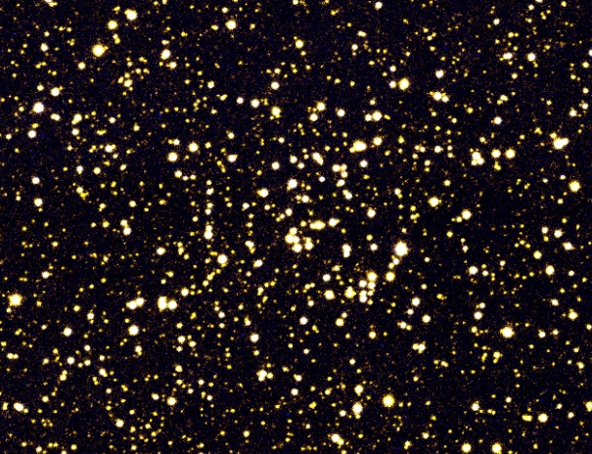
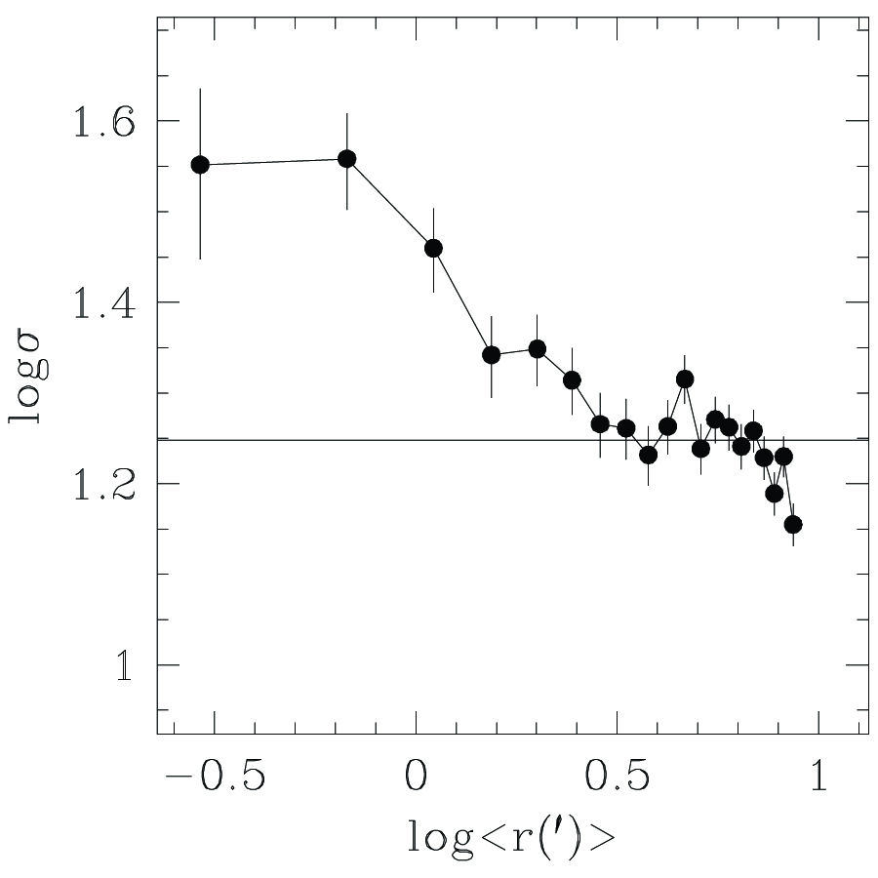
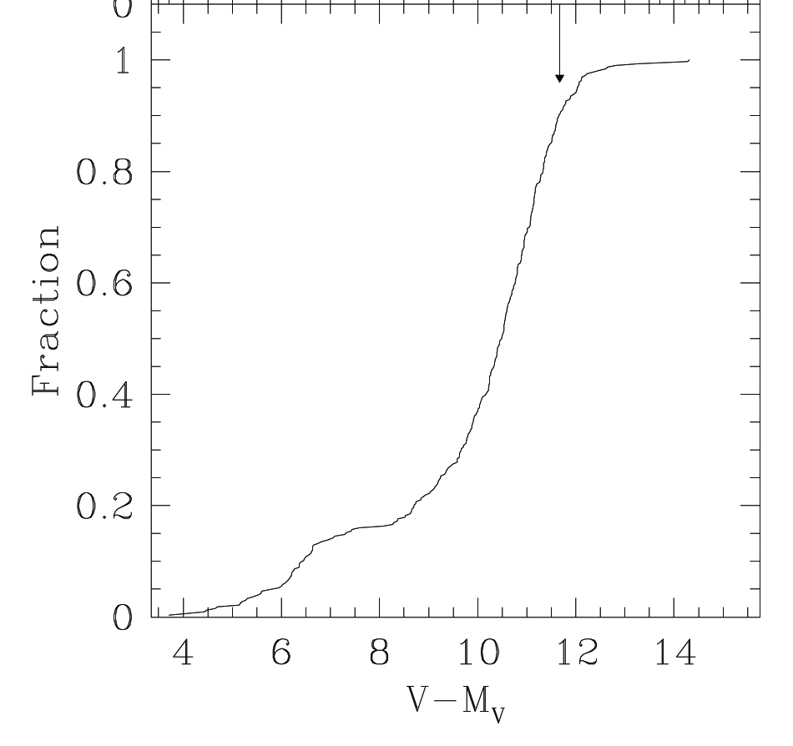
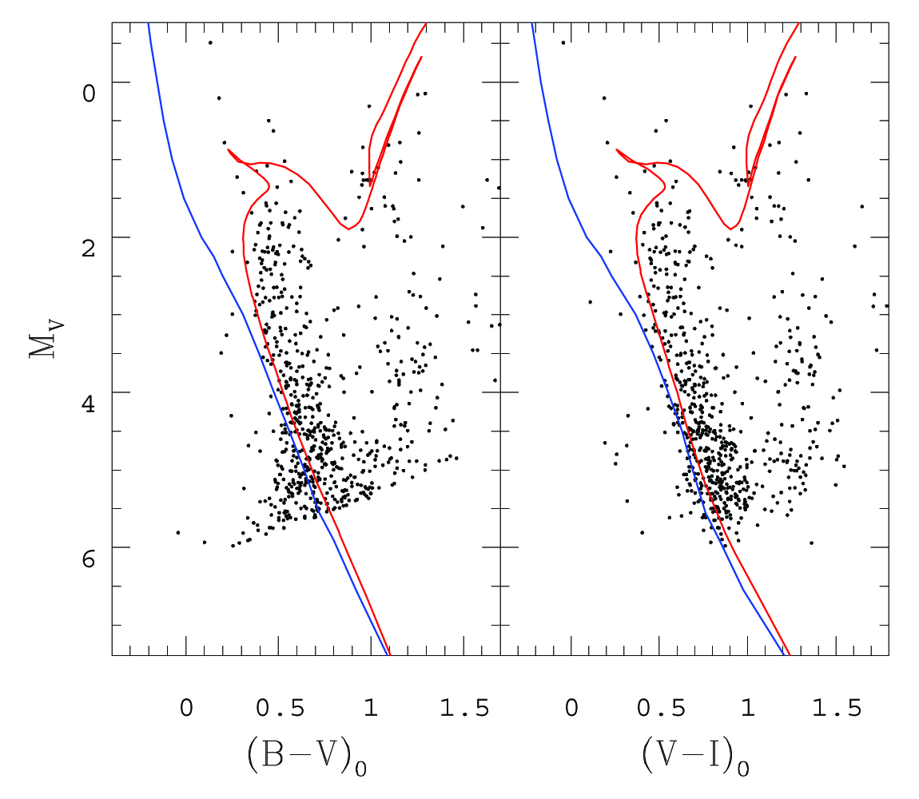
The BAD
Berkeley 44
<E(B-V )>=1.05±0.05
Distance ~ 2.2 kpc
Age (log t) ~ 9.05
Old age

Slide 9
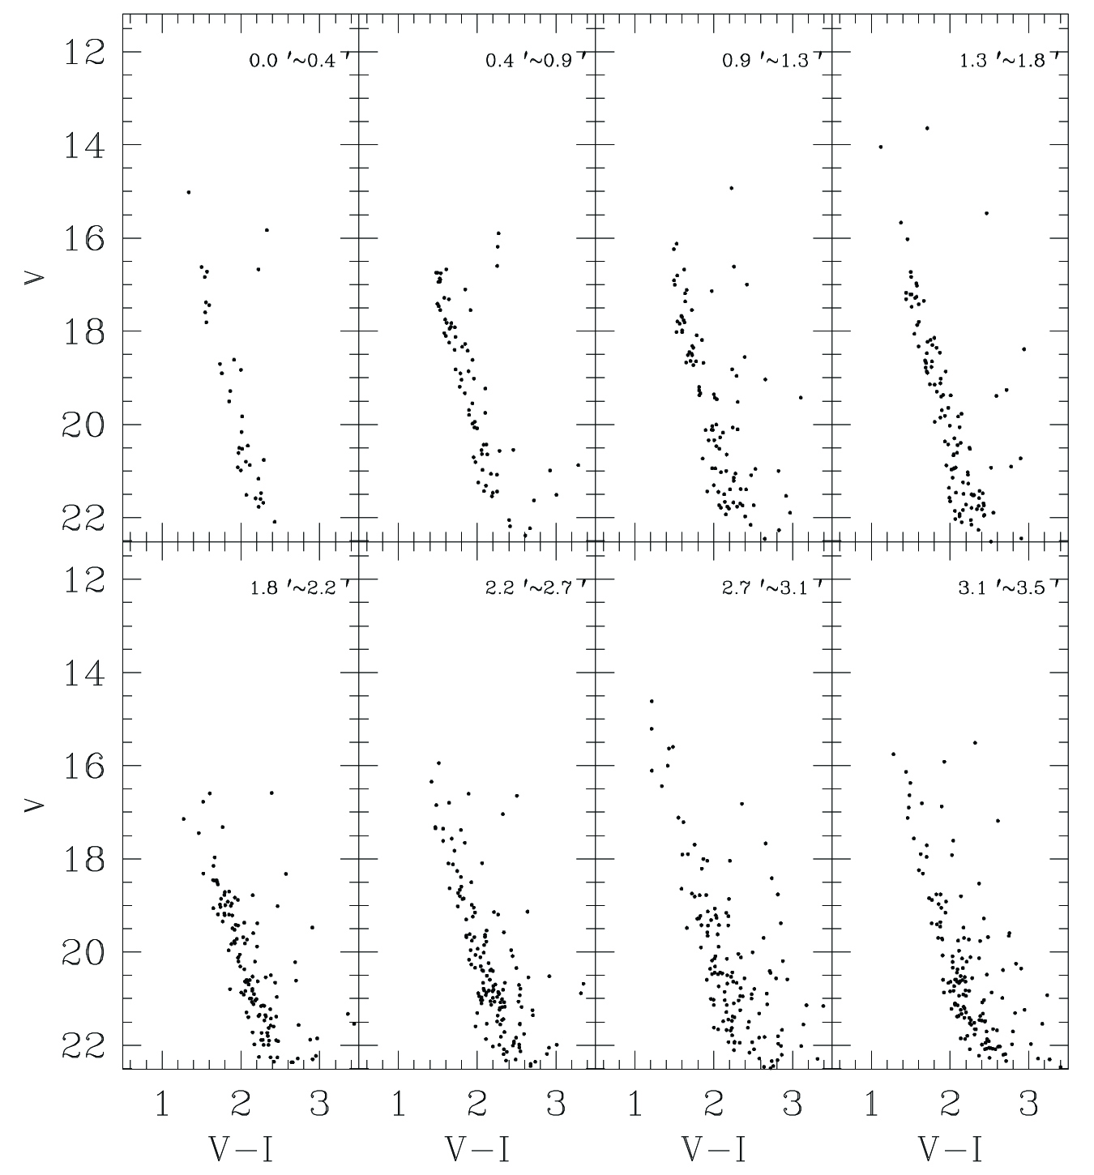
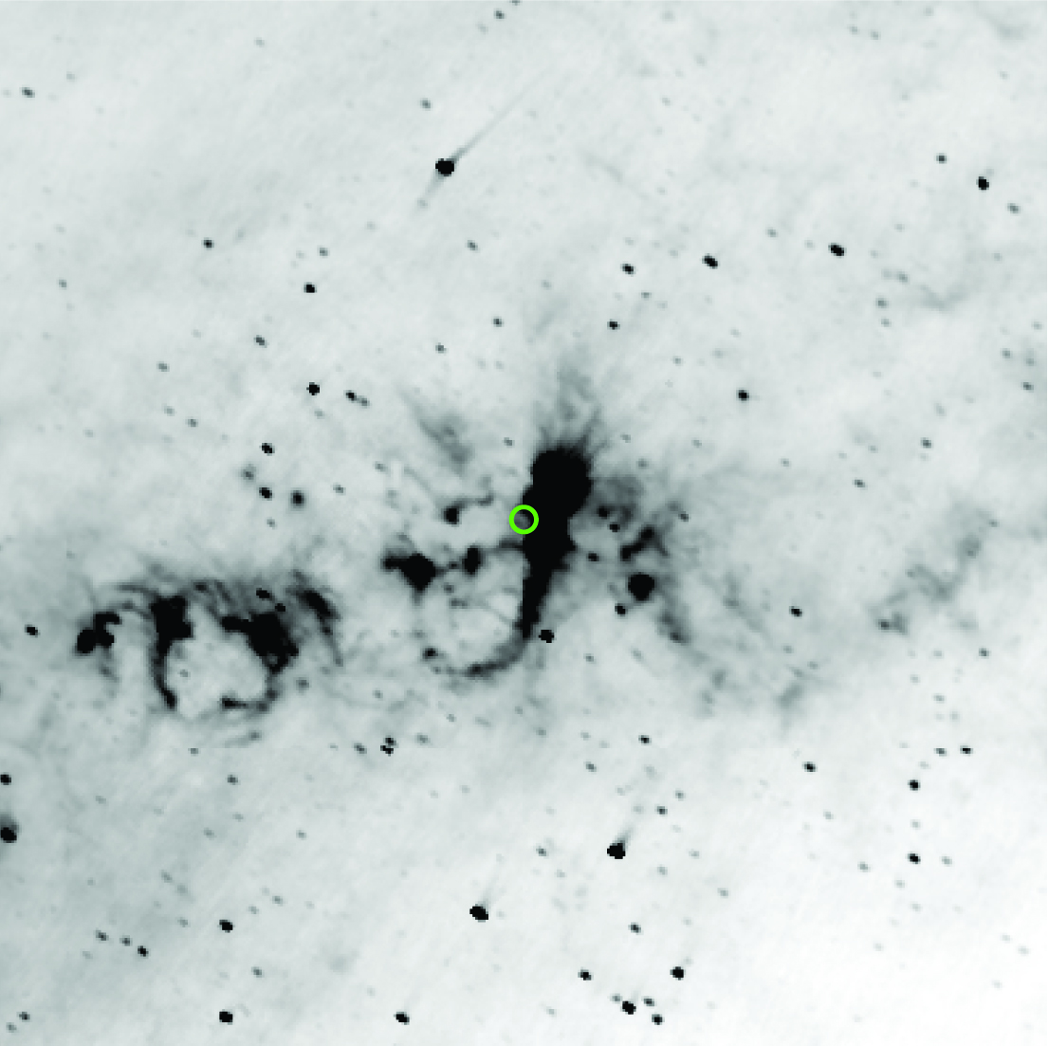
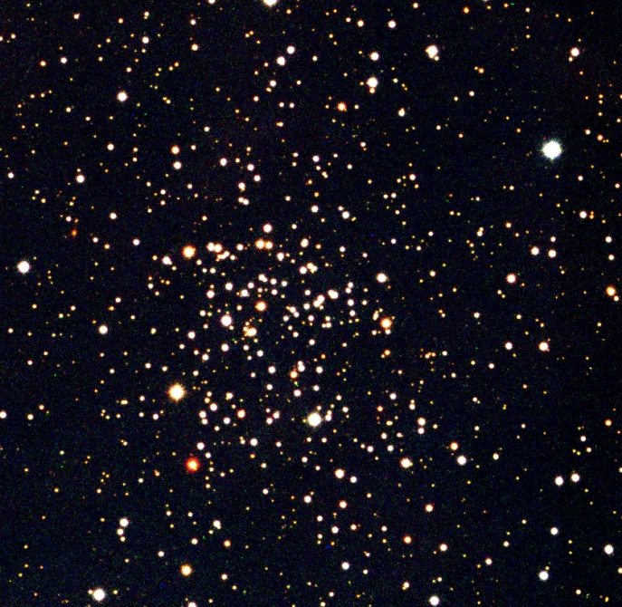
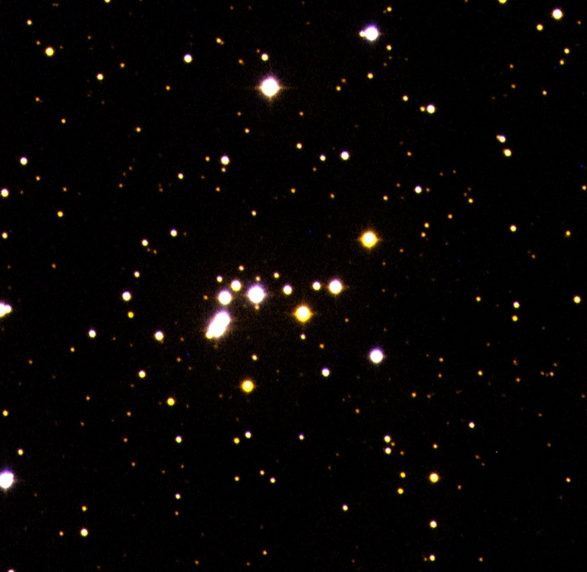
The UGLY
Tombaugh 4
Is it real? Or fake?
Alessi 14

Slide 10
Conclusion
Systematic analysis based on homogeneous data for open clusters can tell us important information on the formation history of the Galaxy and stellar astronomy
SOS project
  Providing homogeneous photometric data
  Systematic analysis for
    Young and intermediate age (the good)
    Old age (the bad)
    Fake clusters? (the ugly)

