Slide 1
Exoplanet Transit Study with Maidanak 1.5m Telescope
The 2nd Maidanak Users Meeting,
UBAI,Tashkent, Uzbek, 2010. 6. 21-25
Sang Gak Lee, Masateru Ishiguro, YunA Yang, Won Suk Kang, Keun Hong Park (Seoul National University)
Sung Ho Lee, Hyun Il Sung, Dong Whan Cho (KASI)

Slide 2
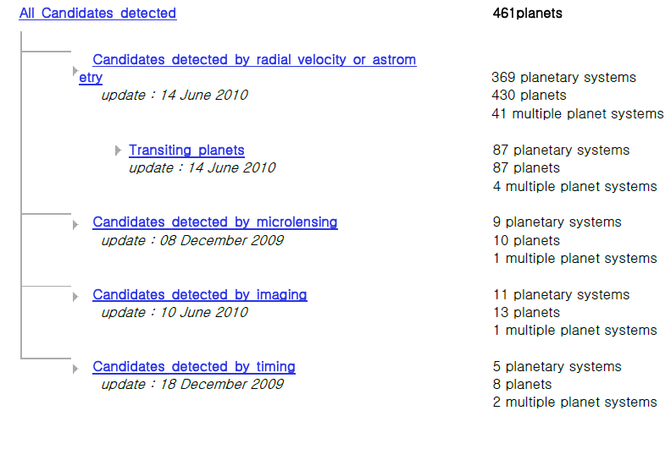

Slide 3
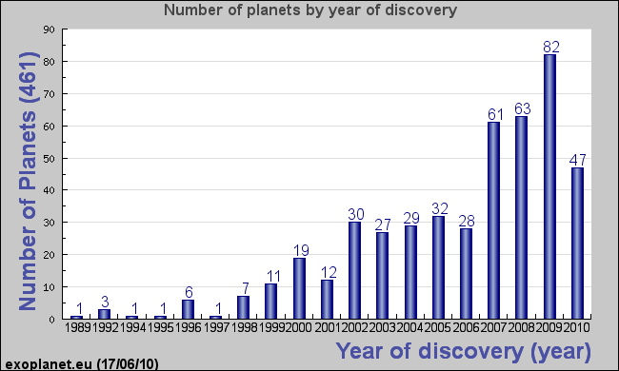
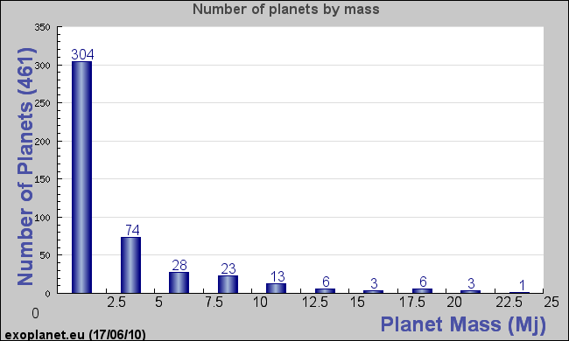
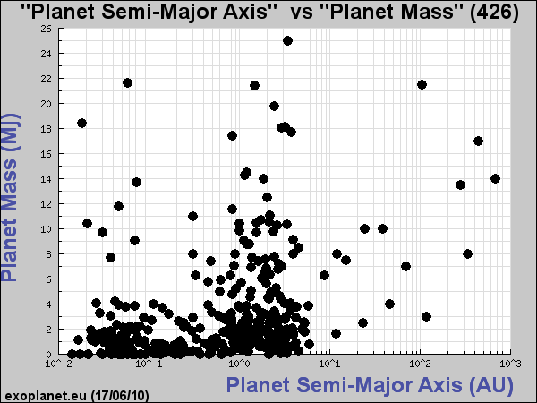
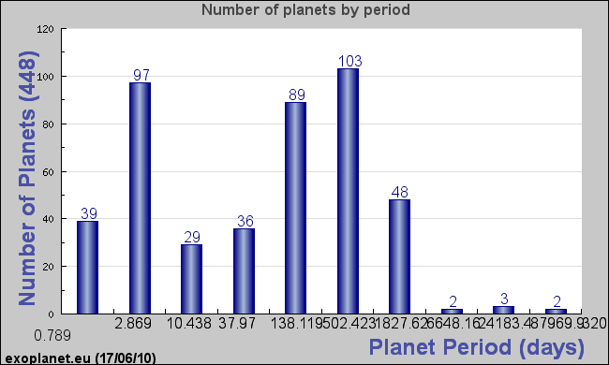
All exoplanets

Slide 4
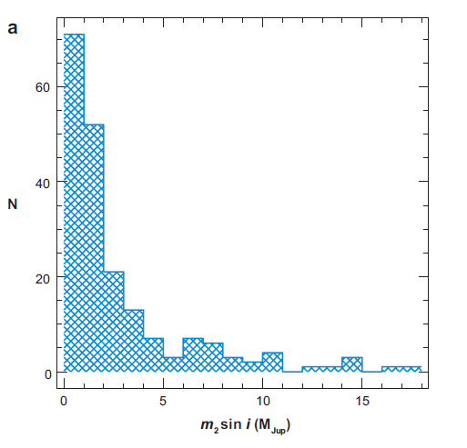
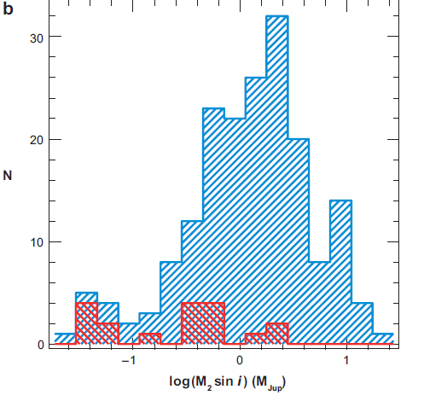
Planetary mass distribution
Planetary mass distribution in linear (a) and log (b) scales, illustrating the steep rise of the distribution toward the lowest masses and the still strong observational bias below the mass of Saturn. The double-hatched histogram in panel (b) indicates the masses of planets detected with HARPS, one of the new generation instruments capable of very high radial-velocity precision (Pepe et al. 2005).

Slide 5
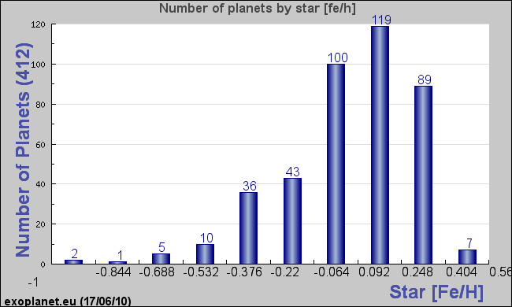
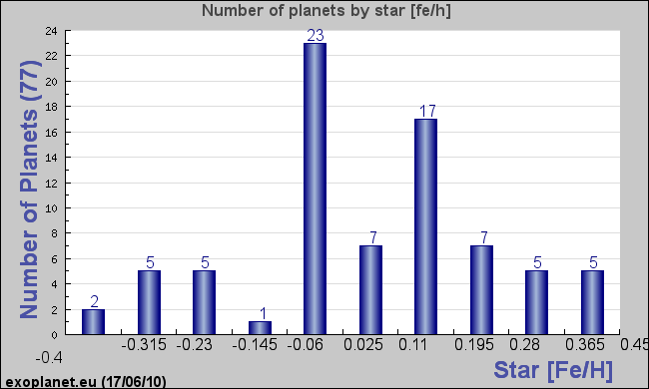
Metallicity distribution

Slide 6
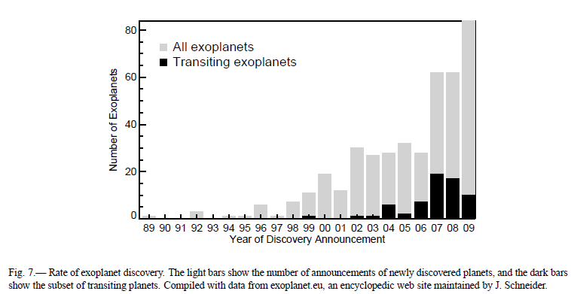
TEPs
OGLE, which used a 1 m telescope to survey 14-16thmagnitude stars; and the TrES, XO, HAT, and SuperWASP surveys, which used 0.1 m lenses to survey 10-12th magnitude stars
two ongoing space-based missions CoRoT and Kepler

Slide 7
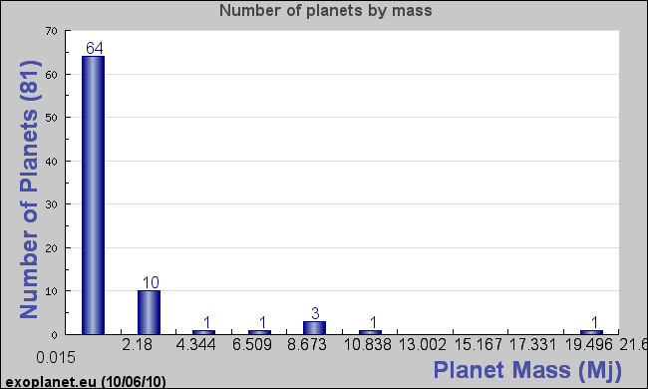
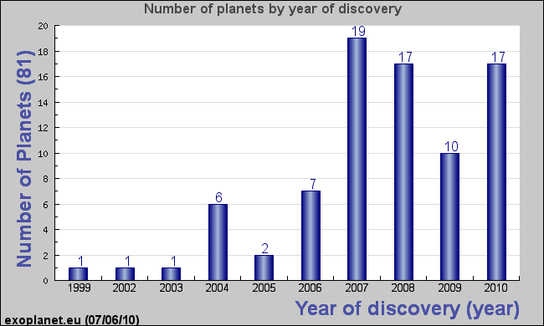
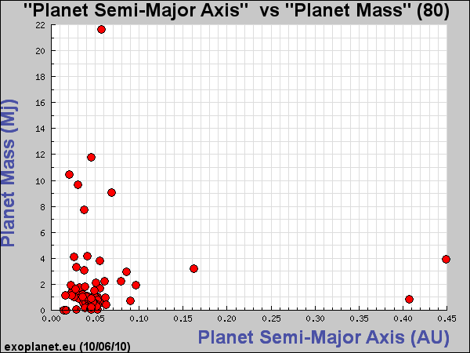
Transiting Planets
PERIOD-SEPARATION
Kepler’s third law (M∗ + Mpl)P² = a³, with p in years and a in AUs
For a solar-mass star, P = 10 days at 0.09 AU (P=5 days at 0.056 AU) or P = 1 year at 1 AU

Slide 8
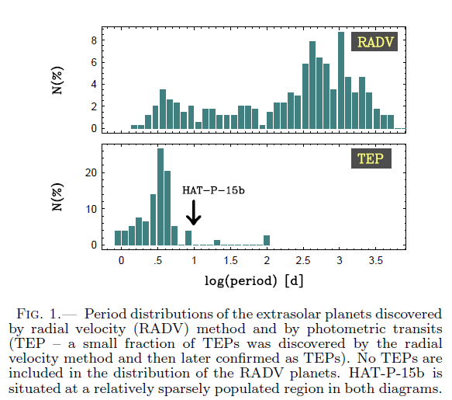
Most TEPs : p < 5days (log P <0.7)
Among Transit ExoPlanets(TEPs) only 7 planets with orbital periods > 6 days.
CoRoT-4b, CoRoT-6b, CoRoT- 9b, HD 17156b, HD 80606b, WASP-8b ( 8.16 days), and HAT-p-15b (10..86 days)
(Kovacs et.al.,2010)

Slide 9
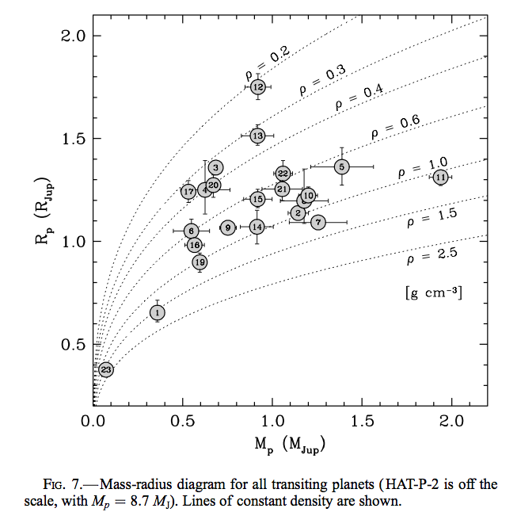
Characteristics of Transiting Exoplanet_ planetary density
Torres et al. 2008

Slide 10
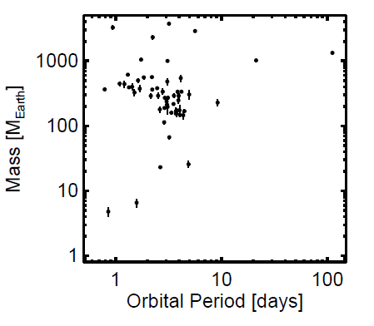
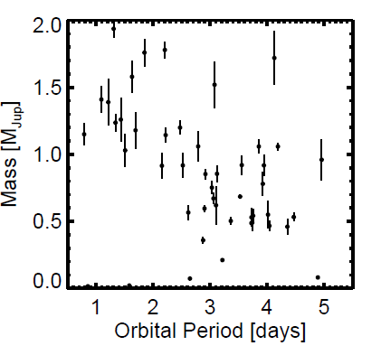
Orbital Period- Planet Mass
(arXiv:1001.2010v2 J. N. Winn)
Mass versus orbital period, on a logarithmic scale. The two long-period outliers are HD 17156b (P = 21 d) and HD 80606b (P = 111 d).
on a linear scale, and with axes restricted to highlight the gas giants. The anticorrelation between mass and orbital period is evident.

Slide 11
Summary for TEPs
As of June 2010, 87 transiting planets are known, represeniting 19% of the total number of exoplants discovered.
Despite the selection effects, the known transiting planets exhibit a striking diversity.
1. They span three orders of magnitude in mass,
and one order of magnitude in radius.
2. Most are gas giants, comparable in mass and radius to Jupiter.
3. Densities of gas giants vary from 0.2 to > 2.0 g cm⁻³

Slide 12
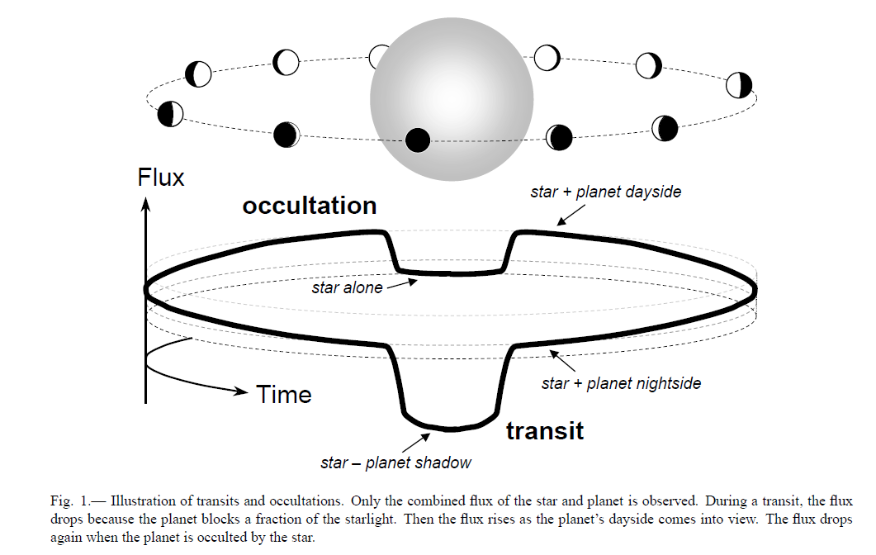
Introduction
Exoplanetary science (Winn et al. 2010)
  Orbit, mass, radius, temperature, and atmospheric constituents of the planet
  From these properties
    Clues about the processes of planet formation and evolution
    Understanding the properties of the solar system
  Transits and occultations
    Transits ; the passage of smaller body in front of the larger body
    Occultations ; the passage of smaller body behind the larger body - secondary eclipses

Slide 13
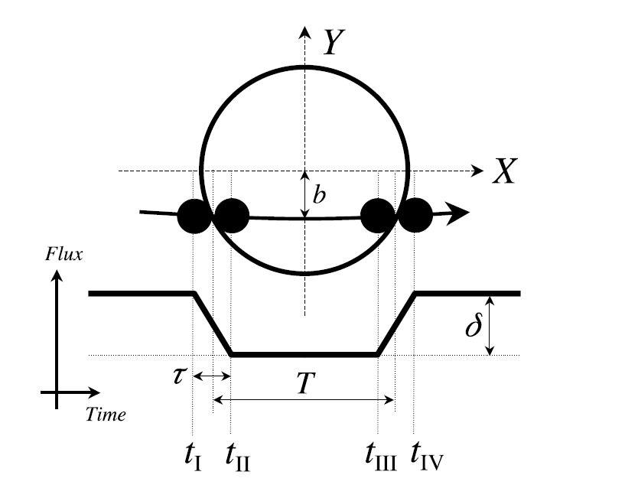
Eclipse Basics (Winn et. Al 2010)
Terminology
  R_{p} / M_{p} ; radius/mass of a planet
  R* / M* ; radius/mass of a parent star
  X, Y, Z direction
    Z
    - toward observer
    b = impact parameter
Z

Slide 14

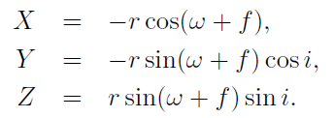
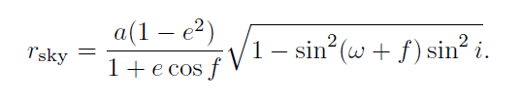
Eclipse Basics
Geometry
  Distance btw. star and planet
    a – semimajor axis of relative orbit
    f – true anomaly implicit function of time depending on the orbital eccentricity e and period P
  Cartesian coordinates
  Projected distance, r_{sky} = (X² + Y²)^{1/2}

Slide 15


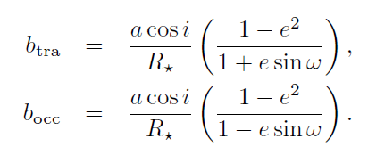


Eclipse Basics
Approximation
  Eclipse are centered around conjunctions, X=0

Slide 16


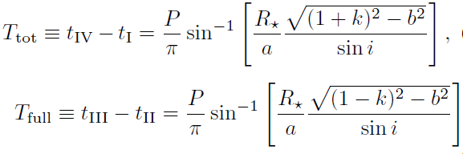
Eclipse Basics –duration
Total, full, ingress, & egress durations

Slide 17
Eclipse Basics

Slide 18


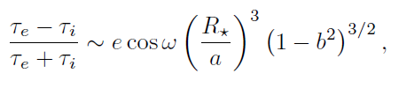

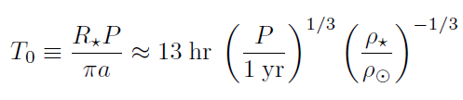
Eclipse Basics
good approximations are obtained by
multiplying Equations (T_{tot}, T_{full}) by

Slide 19
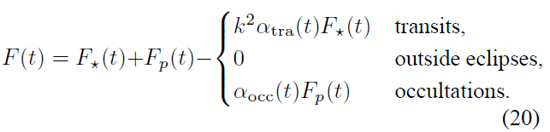


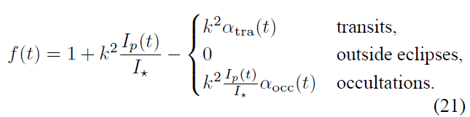
Eclipse Basics
Loss of light during eclipse

Slide 20


Depth
f(t) is specified by the depth δ , duration T , ingress or egress duration τ , and time of conjunction t_{c},
For transits, the maximum loss of light
the planetary nightside is negligible
For occultations

Slide 21



Eclipse Basics-limb darkening
Limb darkening
  Flux decline
    Larger than k² near the center of star
    Smaller than k² near the limb
  Due to variations in temperature and opacity with altitude in the stellar atmosphere
  Approximation for
  The planet provides a raster scan of the stellar intensity across the transit chord
    star spots and plages can be detected

Slide 22
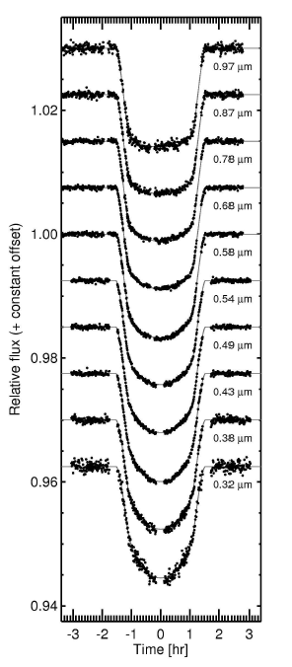
Transits of the giant planet HD 209458b
Transits of the giant planet HD 209458b observed at wavelengths ranging from 0.32 μm (bottom) to 0.97 μm (top). At shorter wavelengths, the limb darkening of the star is more pronounced, and the bottom of the light curve is more rounded. The data were collected with the Hubble Space Telescope by Knutson et al. (2007a).

Slide 23

SCIENCE FROM ECLIPSES
Determining absolute dimensions
a transit light curve reveals the planet-to-star radius ratio k = Rp/R* ~ sqr δ, but not the planetary radius, and says nothing about the planetary mass.
the radial-velocity orbit of the host star, and in particular the velocity semi-amplitude K*.
Kepler’s third law
The observation of transits ensures sin i ~ 1
limit Mp << M *
➔ the data determine Mp/M*^{2/3} but not Mp itself. (required supplementary information of host stars :luminosity, spectral type, Teff, log g, metallicity, stellar mass, radius, composition and age)

Slide 24
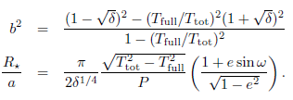

Transit light curve ; b & R*/a
in the limit Rp << R* << a :
τ << T , case for small planets on non-grazing trajectories

Slide 25


Precise Transit Photometry and Doppler Velocimetry
dimensionless ratios R*/a and Rp/a :
(i) set the scale of tidal interactions between the star and planet.
(ii) Rp/a determines what fraction of the stellar luminosity impinges on the planet,
(iii) R*/a determines a particular combination of the stellar mean density ρ∗ and planetary mean density ρ_{p}:
from Kepler’s third law :
➔ k³ is usually small, often negligible, ρ* can be determined purely from transit photometry
possible to derive the planetary surface gravity g_{p} =GM_{p}/R²_{p} independently of the stellar properties

Slide 26
Timing of eclipses
The orbital period P : determined by timing a sequence of transits, or a sequence of occultations
variations in the interval between successive transits, as well as the interval between transits and occultations and the shape of the transit light curve
—due to forces from additional bodies, tidal or rotational bulges, general relativity, or other non-Keplerian effect
➔gradual parameter changes due to precession
➔short-term variations due to other planets or moons

Slide 27
ground-based follow-up observations
precise time-series differential photometry
First find when to observe.
➔ Transit times : predicted based on a sequence of previously measured transit times, by fitting and extrapolating a straight line.
➔ Occultation times : also predicted from a listing of transit times, but are subject to additional uncertainty due to the dependence on e and ω
Next monitor the flux of the target star along with other nearby stars of comparable brightness
➔ with a charge-coupled device (CCD) camera and aperture photometry.

Slide 28
Observation at long-wavelength
1. minimize scintillation and differential extinction, but also to
2. reduce the effects of stellar limb darkening on the transit light curve
➔ Transit light curves observed at longer wavelengths are “boxier,” with sharper corners and flatter bottoms.
➔ this reduces the statistical uncertainties in the transit parameters,
3. but the sky background is bright and variable.

Slide 29
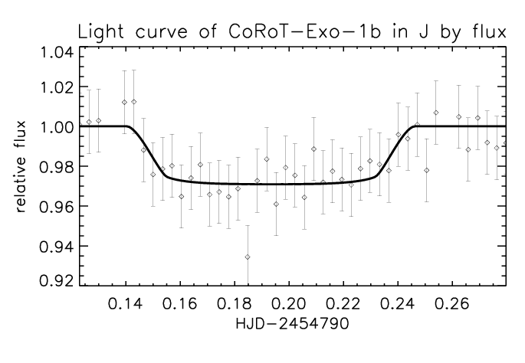
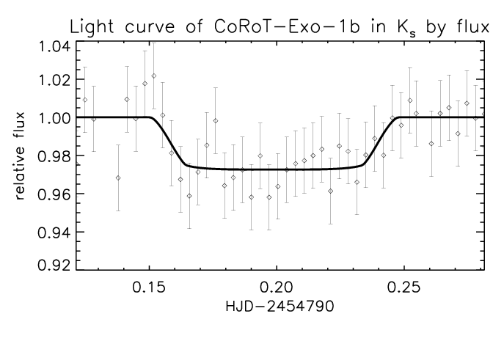
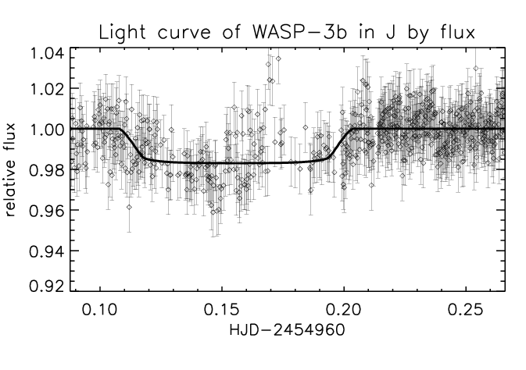
Transit light curves in NIR at BOAO(1)
As a follow-up observation, we can get more improved light curve (in this case, flat-bottom shaped), re-determine transit depth (which corresponds planet-star radius ratio), and check a transit time.
Yang et al. 2009

Slide 30
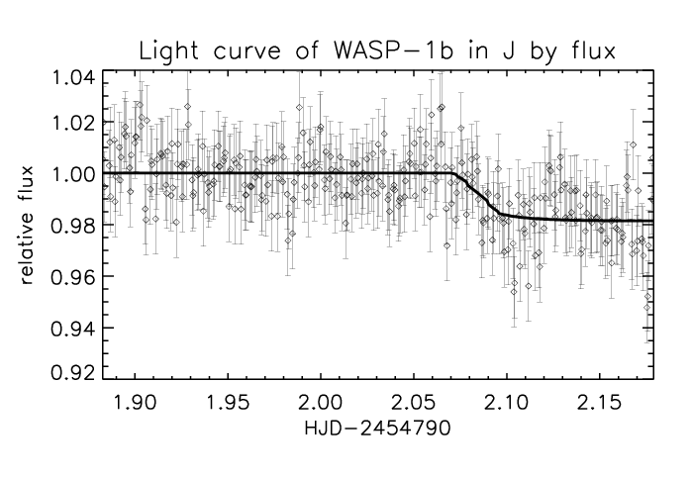
Transit light curves in NIR at BOAO(2):
WASP-1: transit timing is changed?
The real transit occurred about 2 hrs later than the prediction.

Slide 31
International Collaboration for Exoplanet Transit Observation
Optical :
Korea : LOAO (Mt Lemon Optical Astronomy Observatory, Arizona, USA): 1m telescope, (B,V,R,I)
Uzbekistan : Maidanak Observatory : 1.5m telescope, (g,r,i,z,Y)
Egypt : Kottamia Observatory : 1.9m telescope,( B,V,R,I)
IR :
Korea : BOAO (Mt Bohyun Optical Astronomy Observatory ): 1.8m telescope, (KASINICS: J, Ks)
Japan : Nishi Harima Observatory ( J, H, K)

Slide 32

International Collaboration for Exoplanet transit Observation
Maidanak
BOAO
LOAO
Kottamia
Nishi Harima

Slide 33
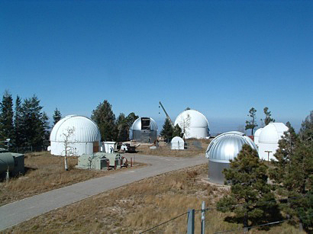
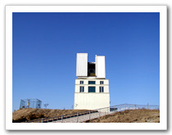
Korea: BOAO, LOAO
LOAO
Long. 110: 47: 19W, Lat. 32: 26: 32N
Altitude: 2,776m
1m Telescope
LOAO
BOAO
BOAO
Long. 128: 58: 35.68E, Lat. 36: 9: 53.19N
Altitude: 1,124m
1.8m Telescope

Slide 34
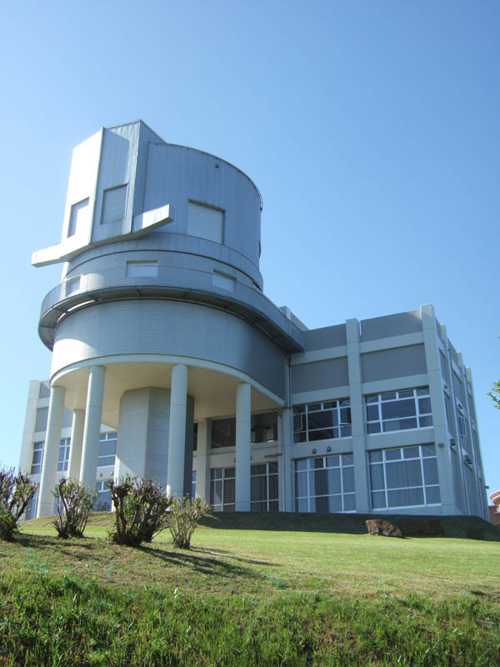

Japan: Hyogo-Prefectural Nishi-Harima Astronomical Observatory (NHAO)
NHAO is located in approximately 100 km northwest of the city of Kobe and 40 km northwest of the Himeji castle, which has been designated as a World Heritage.
It was funded by Hyogo prefecture and started its activities in 1990 when the 0.6 m telescope came on line. In 2004 the 2-m Nayuta telescope entered into the operations.
Nayuta 2-m dome
Presentation by M. Ishiguro, 2009

Slide 35

Uzbekistan: Maidamak observatory
Long. 66: 53: 47E, Lat. 38: 40: 24N
Altitude: 2593m
1.5m Telescope

Slide 36
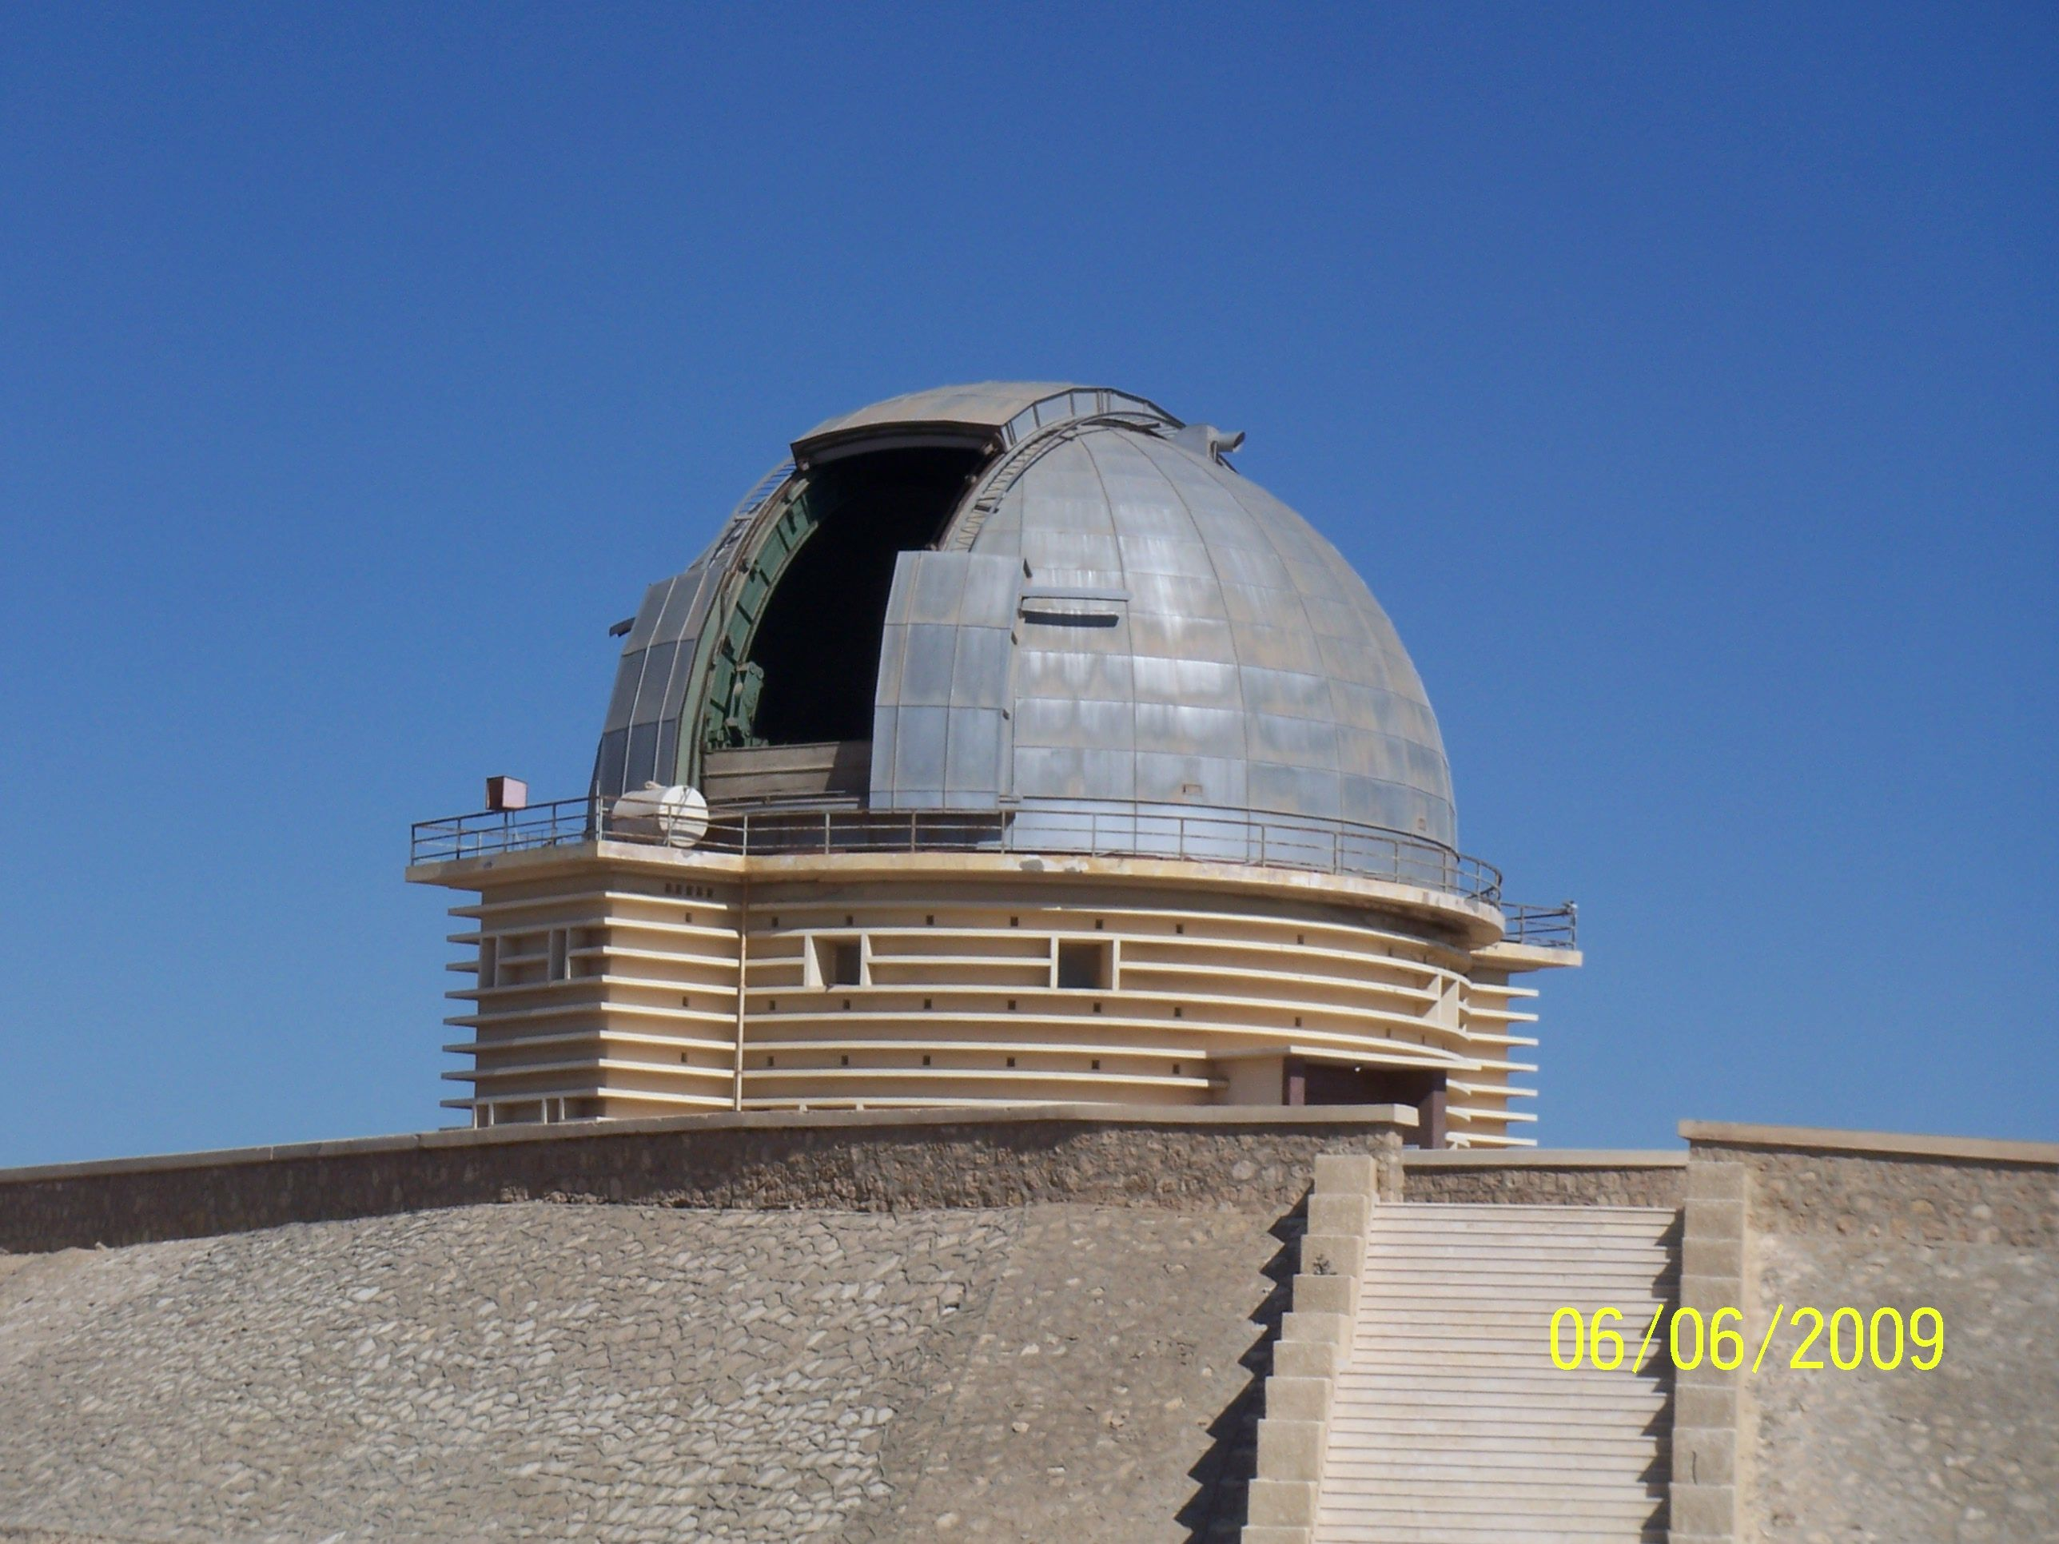
Egypt: Kottamia observatory
Long. 31: 49: 45.85 E, Lat. 29: 55: 35.24N
Altitude 482.7 m
1.9m Telescope

Slide 37
Thank you

