Slide 1
Optical Identification of Infrared Sources in the AKARI NEP Survey Field
Hyung Mok Lee
Seoul National University
In collaboration with
Seong Jin Kim, Yiseul Jeon, Myungshin Im
+ NEP team

Slide 2
I am going to talk about…
Introduction to AKARI
NEP-Wide Survey: introduction and data reduction
Confirmation of sources
  Optical/NIR identification
  Cross-identification within AKARI bands
Summary and suggestion

Slide 3
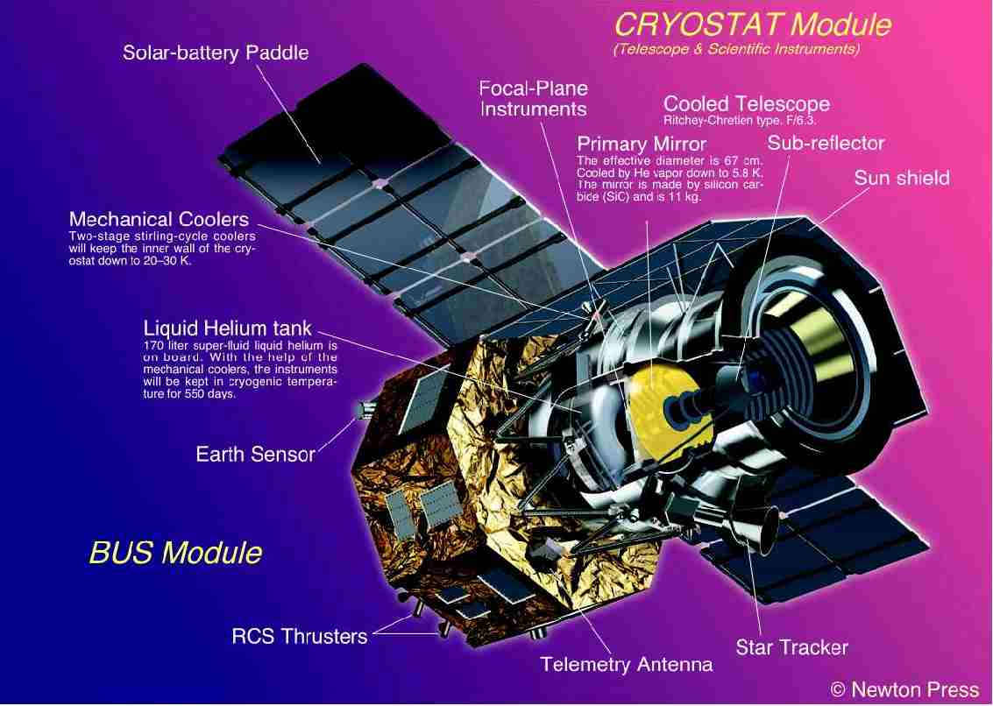
The AKARI (ASTRO-F) Project
IR Space Mission by Japan Aerospace Exploration Institutes (JAXA)/Institute for Space and Aeronautical Science (ISAS) with ESA support
Collaborative Institutes in Japan:
- University of Tokyo
- Nagoya University
- Communications Research lab.
- National Astronomical Observatory (NAOJ)
International Collaboration
- Seoul National University (Pre- and post-flight simulations/data reduction)
- European Consortium (Imperial, Open Univ., Sussex, Groningen: data reduction)

Slide 4
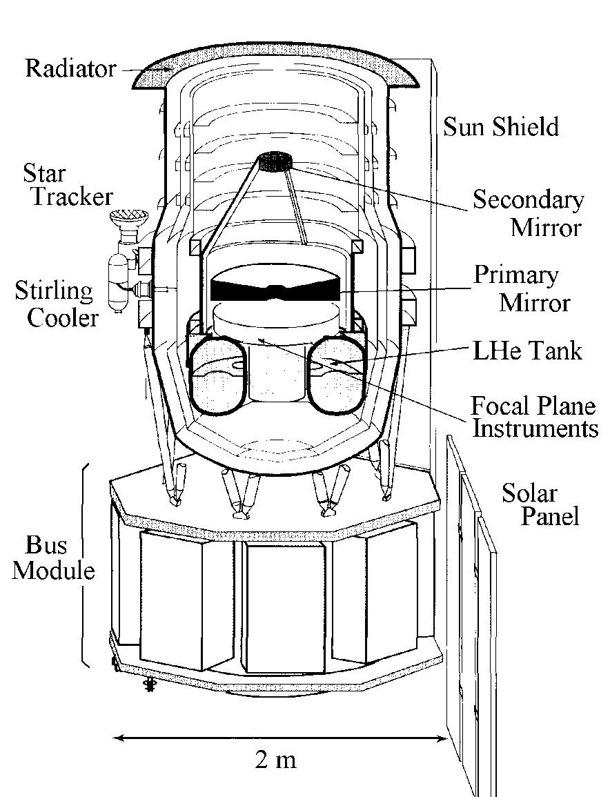
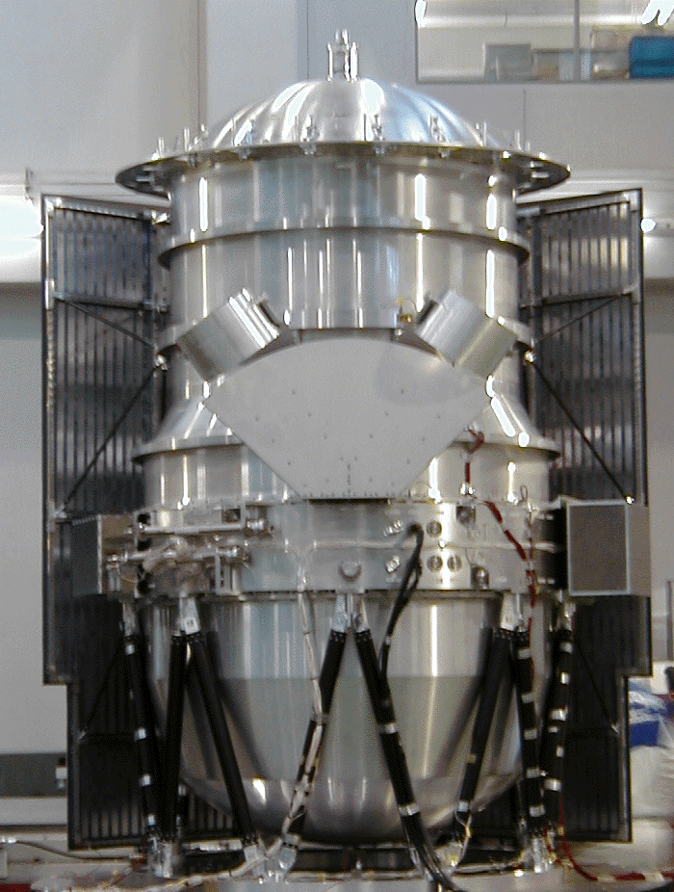
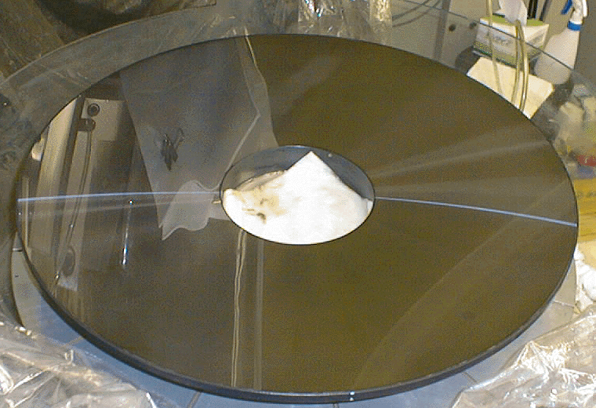
Telescope
Mirror
  68 cm, F/6
  SiC
Cryogenic System
  170 liter LHe + Stirling Cooler
  T(tel) = 5.8 K,
  T(detector) = 1.8 K (st. Ge:Ga), 15 K (InSb)

Slide 5
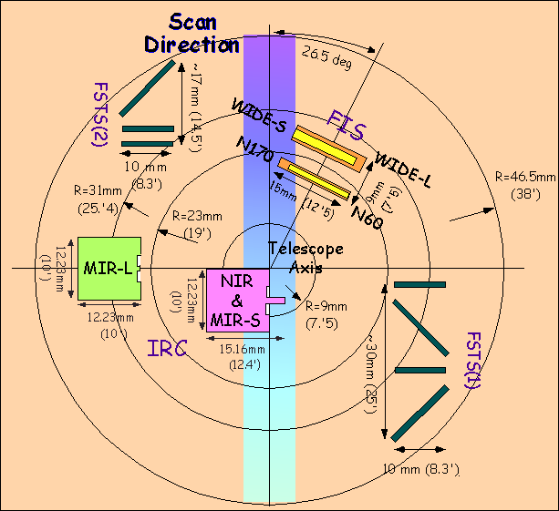
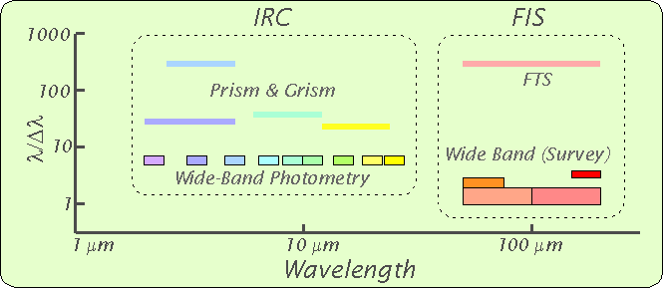
Focal Plane
Instruments
IRC: Near- and Mid-IR Camera
FIS: Far-IR Surveyor

Slide 6
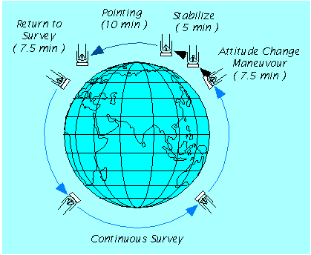
Orbit and Observing Modes
Sun Syncrhonous Orbit with a=7081.093 km e=0.002102013
Altitude ~ 750 km
Orbital Period ~100 minutes
Max Pointings 3 / revol.
Pointing Obs.
< 10 min per pointing
The telescope visits NEP and SEP in every orbit!

Slide 7
Features
Main purpose: all sky survey in mid to far infrared + pointing observations
Higher resolution compared to IRAS (e.g., 0.5-0.8’ compared to 6’ at far IR)
Wide field of view (10’ x 10’ for IRC)
Wide and continuous wavelength coverage from near to far IR (2-170 microns) for both wide-band imaging and spectroscopy
Scientific programs include all sky survey, large area surveys (NEP, SEP), Mission Programs, and open time programs

Slide 8
FIS All Sky Survey: Version 1.
Release of Bright Source Catalogue Version 1 on March 30, 2010 (available at
http://www.ir.isas.jaxa.jp/ASTRO-F/Observation/PSC/Public/)
Catalogue at a glance (cf, IRAS PSC has ~ 250,000 sources)
Band | Number of Sources
9 μm | 844,649
18 μm | 194,551
N60 (65 μm) | 28,779
Wide-S (90 μm) | 373,553
Wide-L (140 μm) | 119,259
N-160 (160 μm) | 36,857

Slide 9
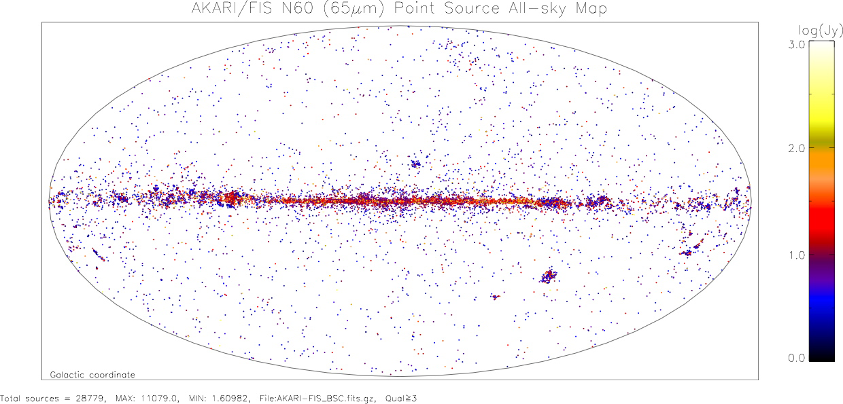
Far Infrared Survey: 65 μm

Slide 10
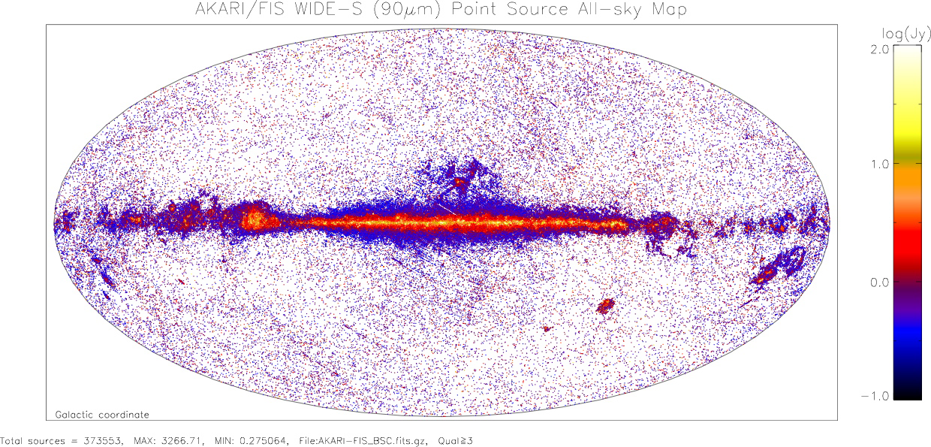
Far Infrared Survey: 90 μm

Slide 11
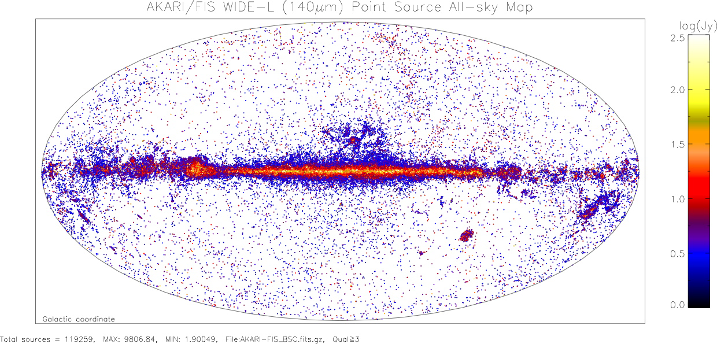
Far Infrared Survey: 140 μm

Slide 12
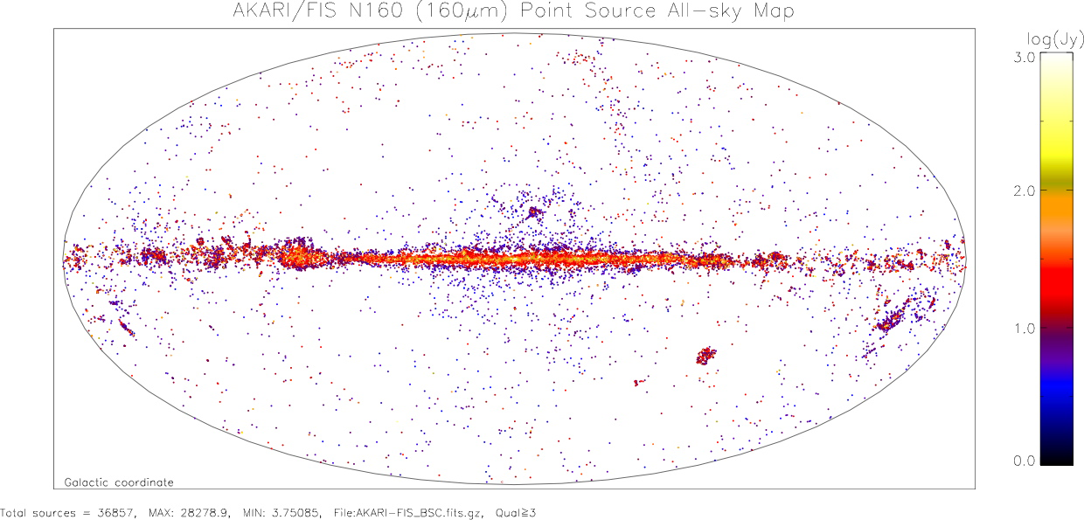
Far Infrared Survey: 160 μm

Slide 13
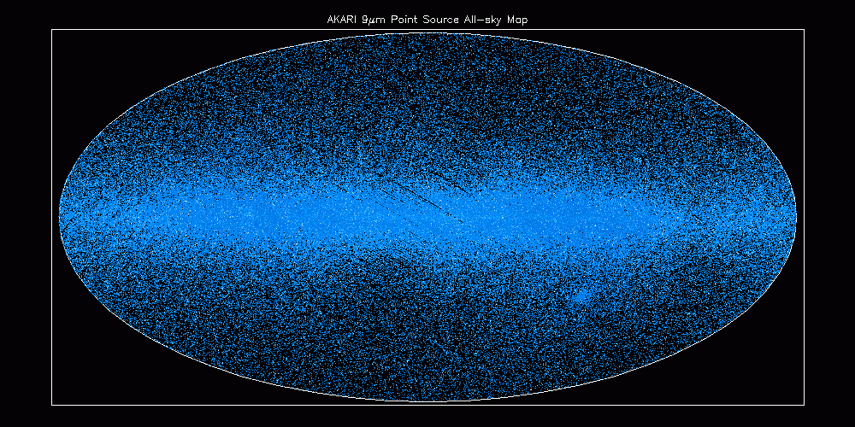
MIR Survey: 9 μm
~844,600 sources

Slide 14
NEP Surveys
One of the Large Area Surveys of AKARI because of high visibility
Consists of Deep (0.38 sq. deg) + Wide area (5.8 sq. deg.) surveys (Matsuhara et al. 2006)
Covered by 9 NIR and MIR bands of AKARI’s IRC (2-24 μm)
Other wavelength data:
- Optical surveys that include the NEP Deep area are done with CFHT (Hwang et al. 2007) and Subaru Suprimecam
- Optical survey for the entire NEP Wide survey area has been carried out using 1.5 m Telescope at Maidanak Observatory by SNU team (to be reported by Yiseul Jeon tomorrow) + Ground based NIR (J, H, K) data
- Radio survey with WSRT at 20 cm has been carried out by Open Univ. team .

Slide 15
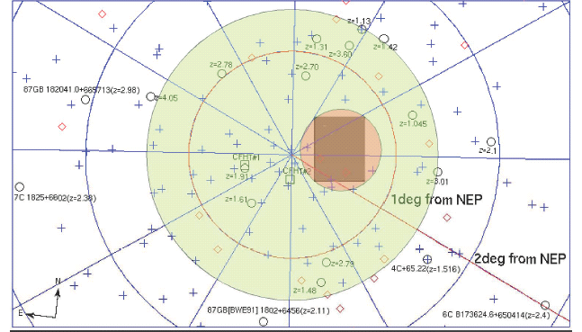
NEP Survey Area
Green: Wide
Pink: Deep
Yellow: CFHT Optical Survey

Slide 16
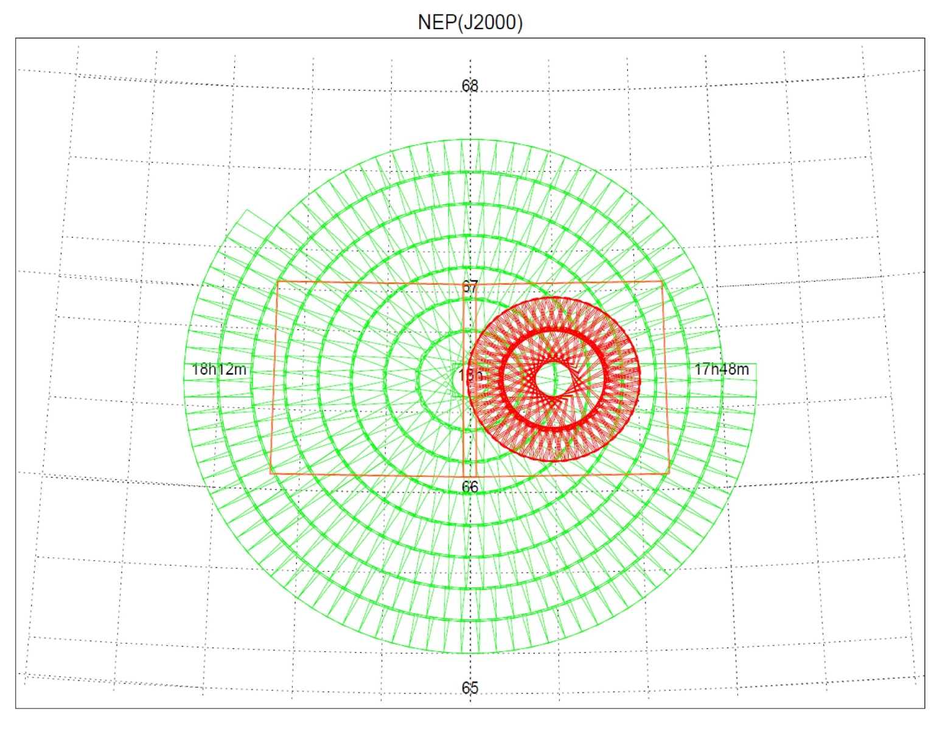
Survey Strategy
NEP-Wide
CFHT
NEP-deep

Slide 17
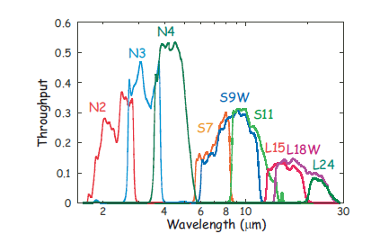
Uniqueness of NEP-Wide
Wide area survey with continuous wavelength coverage from 2 – 24 micron (aside from optical data)
cf: SWIRE survey of Spitzer: IRAC + MIPS has a gap at 8-24 micron
Spitzer has a gap here.
Onaka et al. 2007

Slide 18
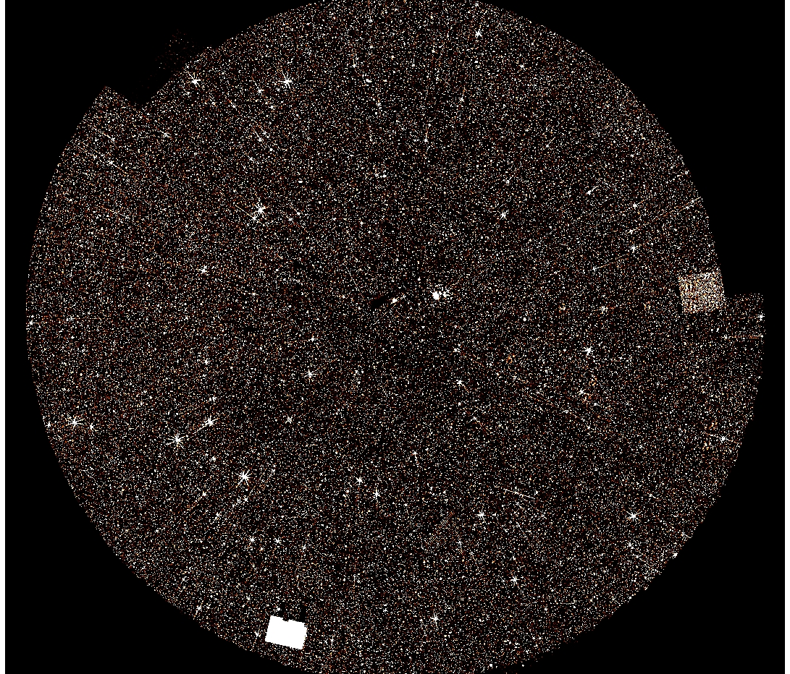
Band merged mage : N2+N3+N4+S7+S9+S11+L15+L18
97060 sources
are detected

Slide 19
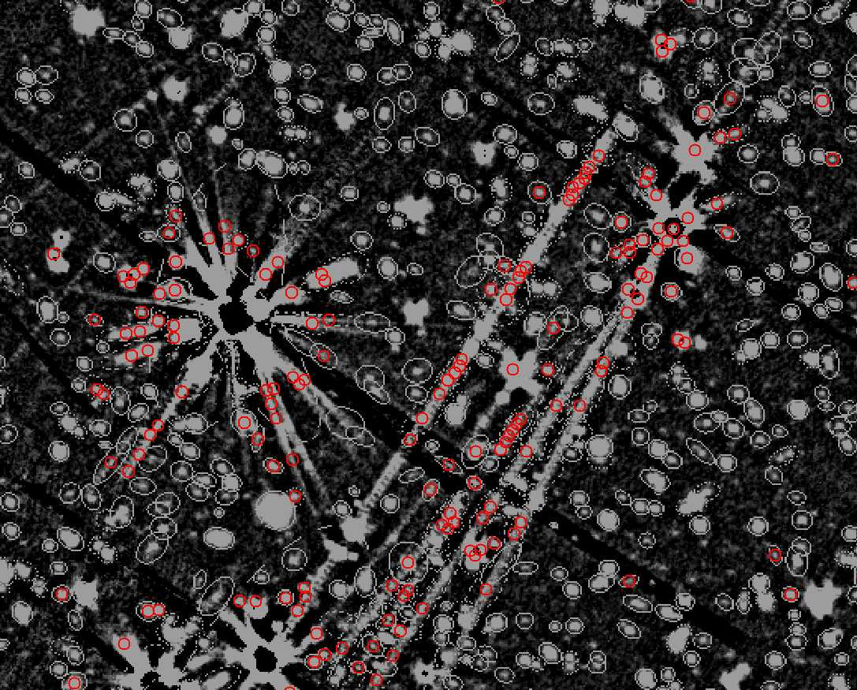
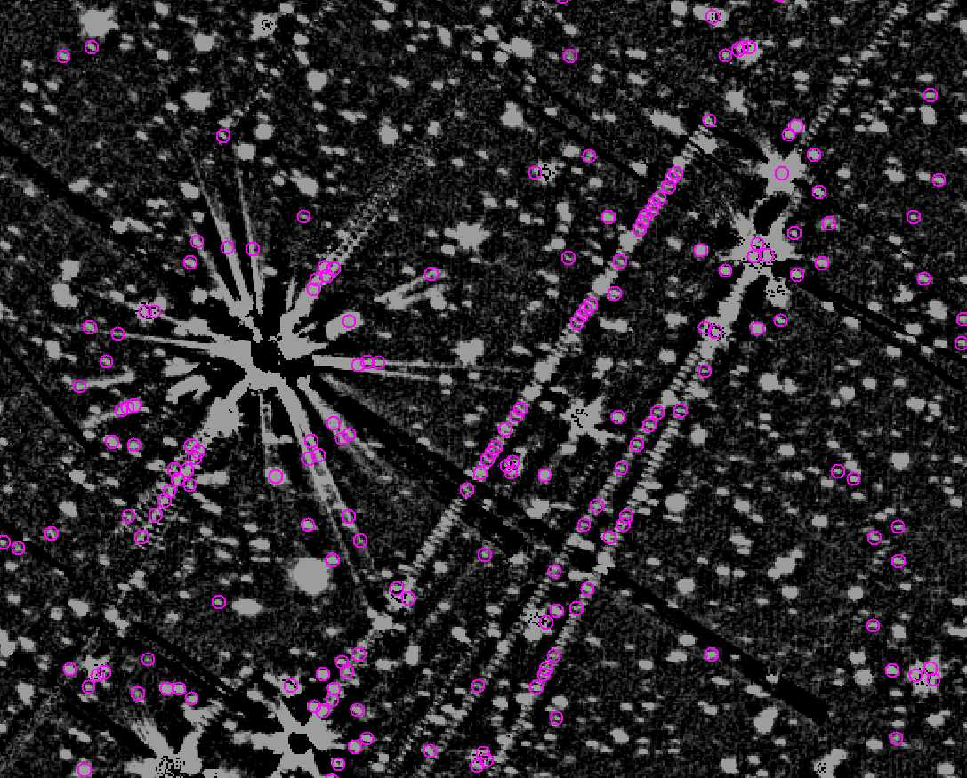
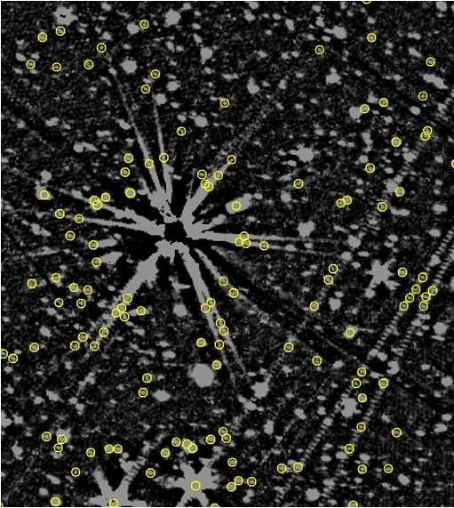
Problems of the AKARI Images
There are many fake objects!
many of them are due to the MUX-bleedings around extremely
bright objects, and they’re serious in NIR (sometimes in MIR).
Ex.
N2
N3
N4
Colored circles are mostly fake objects: they do not have any optical counterpart

Slide 20
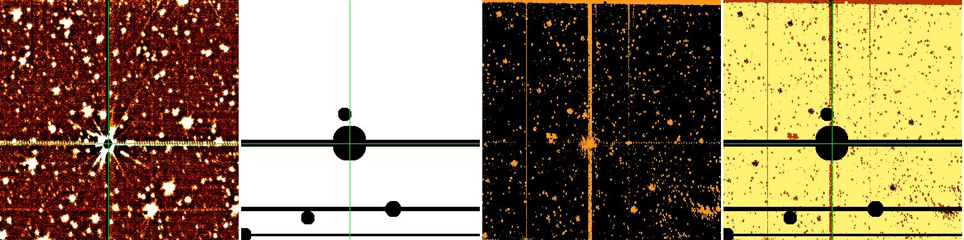
How to remove fake objects?
generate mask image & weight map !
❑ make a map to give different weight depending on the region.
❑ give no weight on the MUX-bleeding area we want to remove.
org image data
mask image
N_comb - pl file
final map
X
=
ex 1 : 2110506
example image
(= individual pointing data)
Region
to be masked
Region
to be masked
pl file from the pipeline
(the number of rejected frames)
final weight map
for mosaic (SWarp)
We have too abandon
this dark (black) area
a schematic view showing how to make a final weight map
How to choose the masking area?

Slide 21
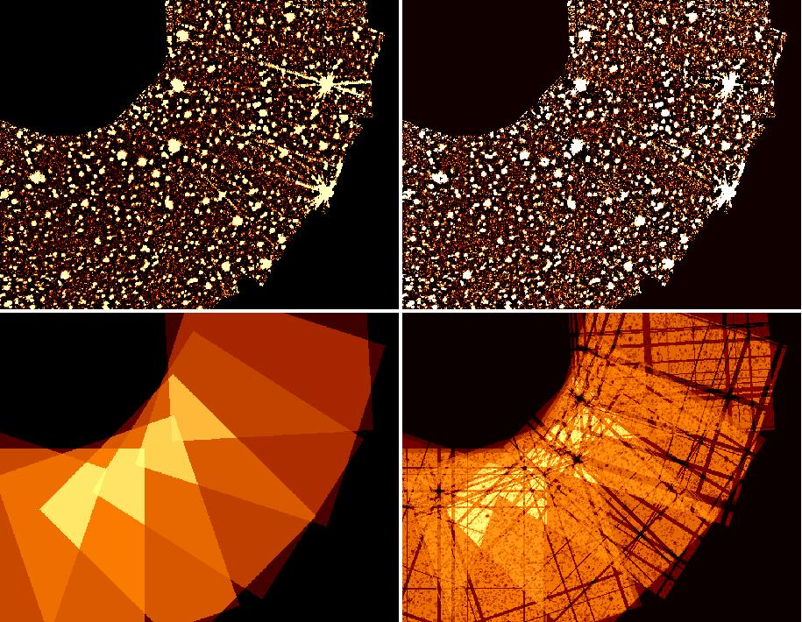
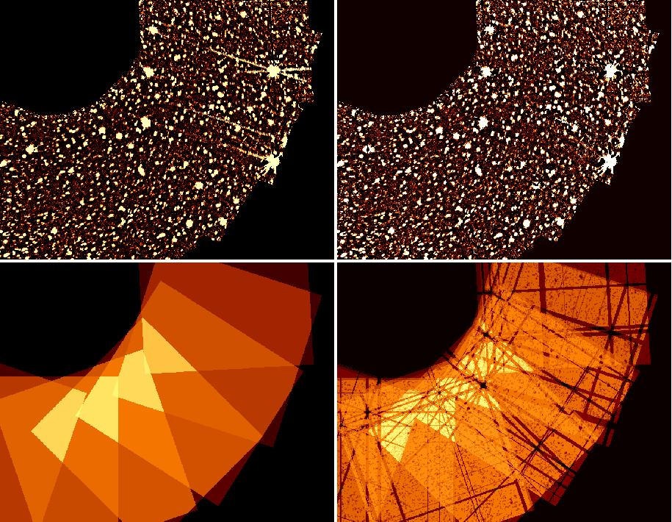
does it work ?
yes, we saw that it is effective.
❑ the preliminary test showed that the mux-bleedings
are removed or weakened by this region-masking method.
N2
N3
image
image
weight map
weight map
figures are showing the comparison of before / after this operation applied to this sample region
( mosaic images are generated using SWarp )

Slide 22
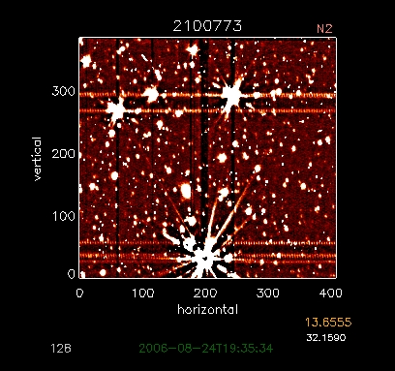
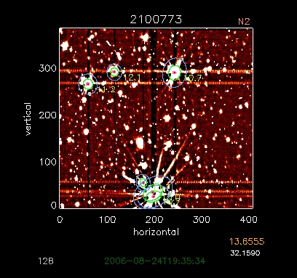
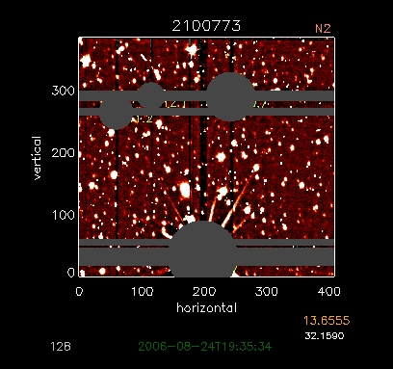
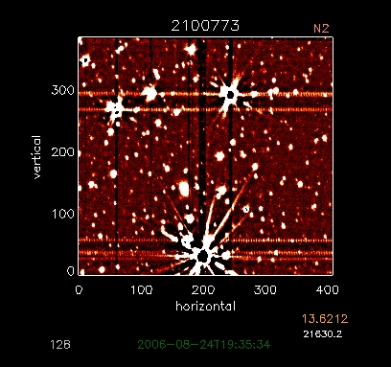
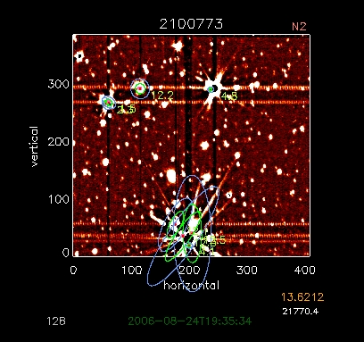
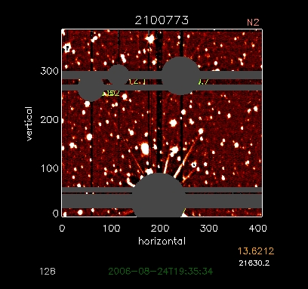
How to define the masking region
find the extremely bright sources
and trace the MUX-bleeding effectively
photometric test for individual pointed observation
in order to decide the masking region for each frame,
we did SExtraction for both (before/after cosmic-ray rejection) cases and used the results
a single frame hit by cosmic-ray
after the correction (cosmic-ray rejection)
colored ellipses indicate the sources brighter than 12.6th mag(AB)
we can see what happened during the procedure of cosmic-ray rejection (LA-cosmic)
and how we should make a mask image for each individual frame

Slide 23
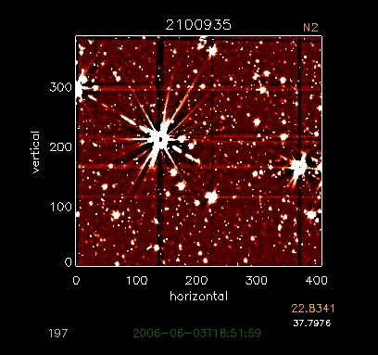
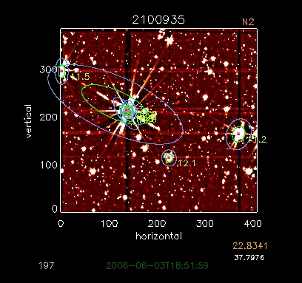
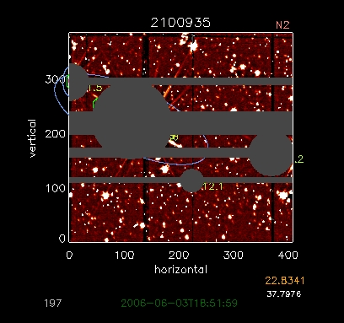
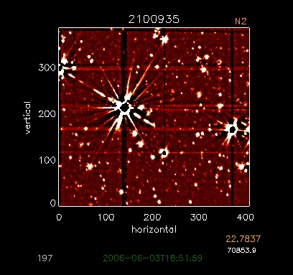
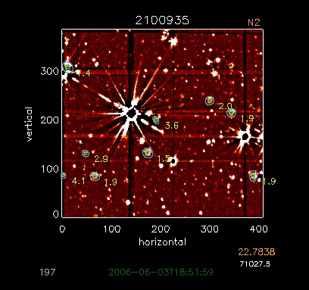
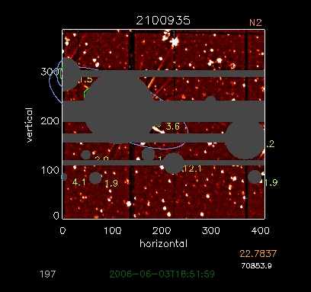
how to define the masking region
find the extremely bright sources
and trace the MUX-bleeding effectively
photometric test for individual pointed observation
in order to decide the masking region for each frame,
we did SExtraction for both (before/after cosmic-ray rejection) case and used the results
Ex. 2
a single frame hit by cosmic-ray
after the correction (cosmic-ray rejection)
colored ellipses indicate the sources brighter than 12.6th mag(AB)
we can see what happened during the procedure of cosmic-ray rejection (LA-cosmic)
and how we should make a mask image for each individual frame

Slide 24
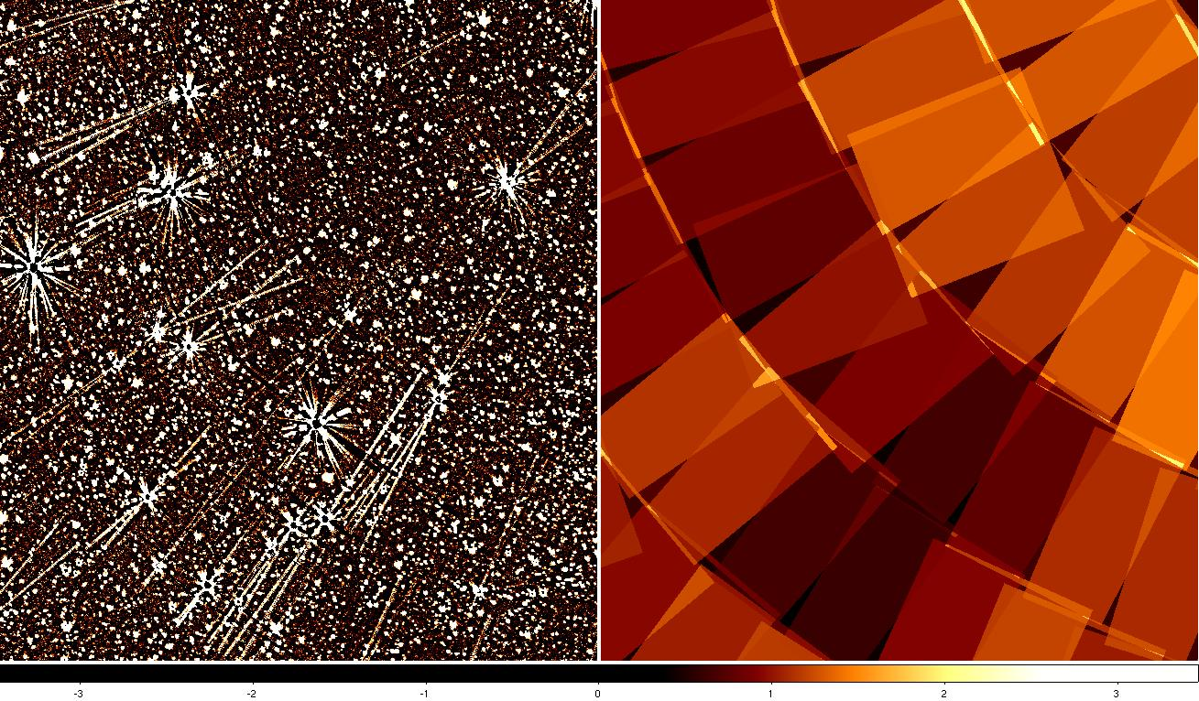
result (comparison)
the previous results
“previous version of N2 mosaic image, ”
PREVIOUS
before vs after this operation
( mosaic images are generated using SWarp )

Slide 25
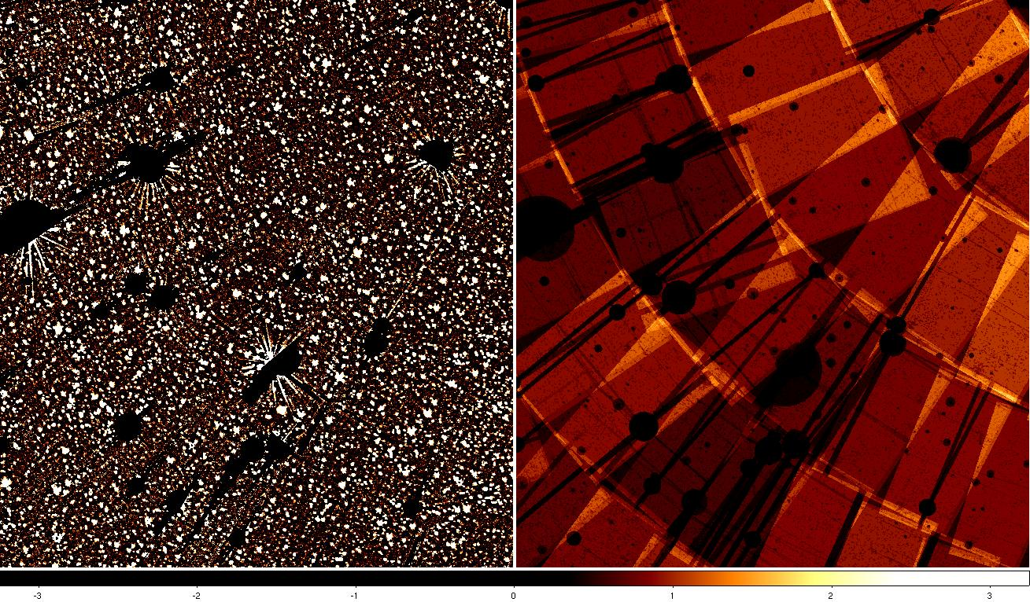
result (comparison)
the final stage
“updated result of the same region & final weighted map”
FINAL
SWARP parameter
-BLANK_BADPIXELS Y
-COMBINE_TYPE WEIGHTED
-WEIGHT_SUFFIX . weight.fits
before vs after this operation
( mosaic images are generated using SWarp )

Slide 26
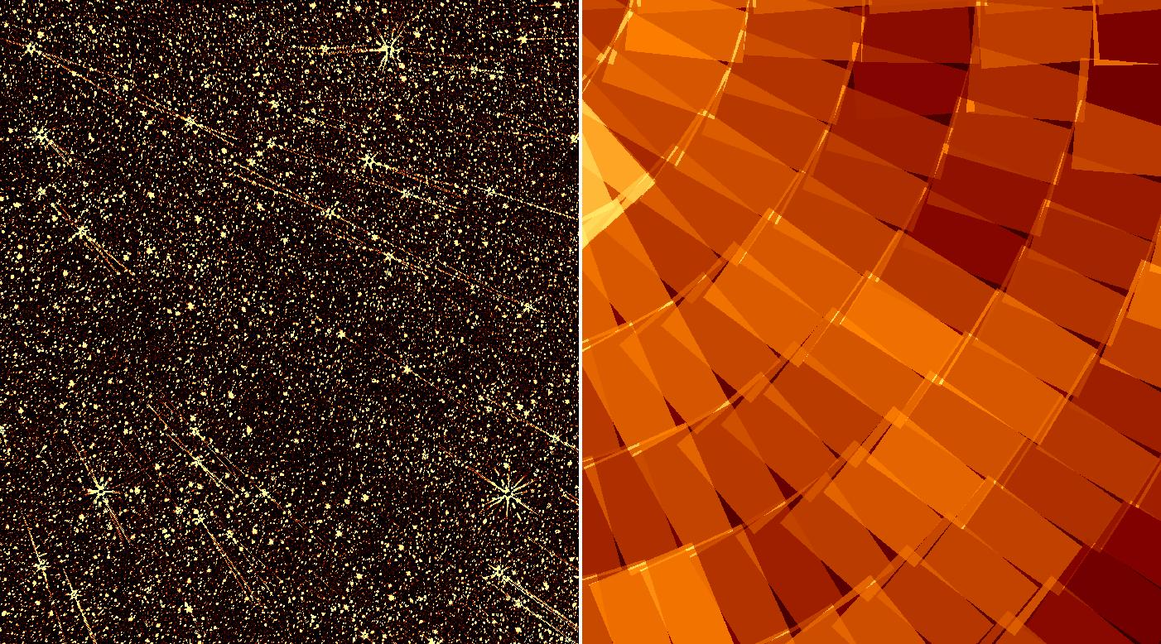
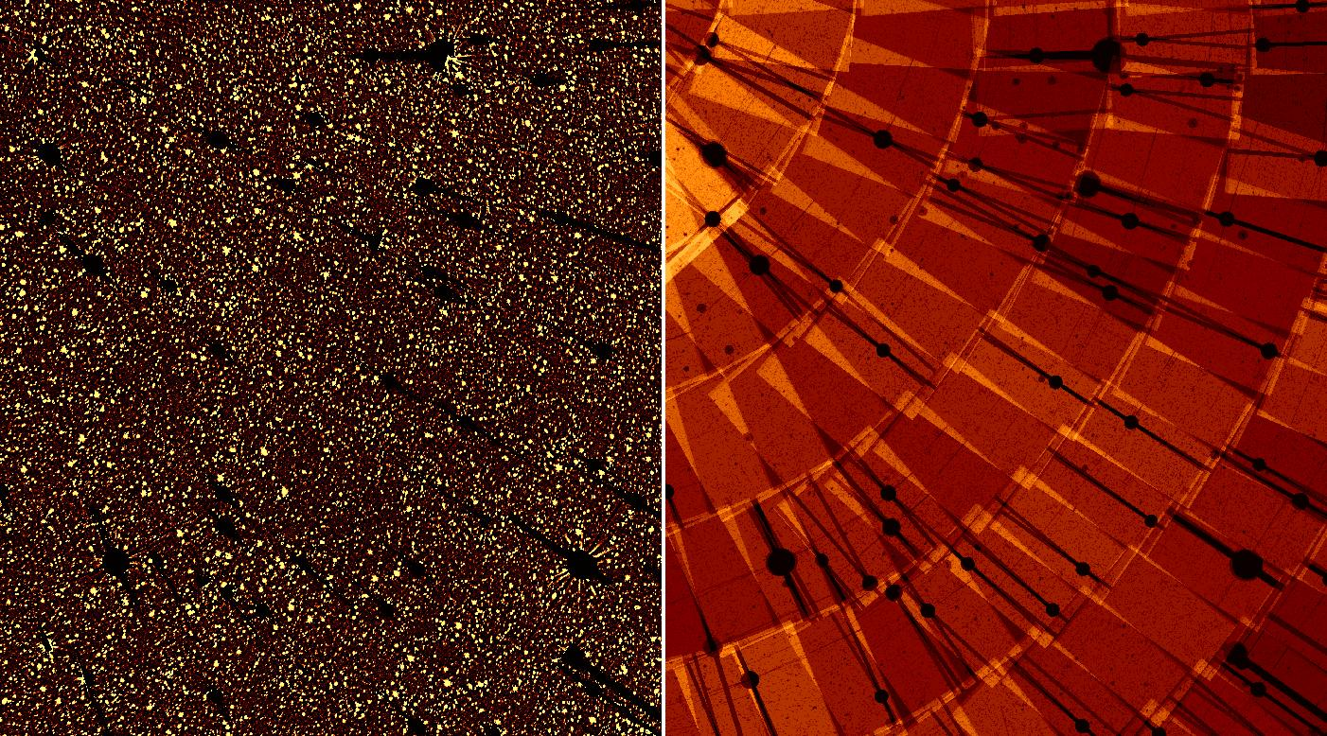
Final Mosaic of N3

Slide 27
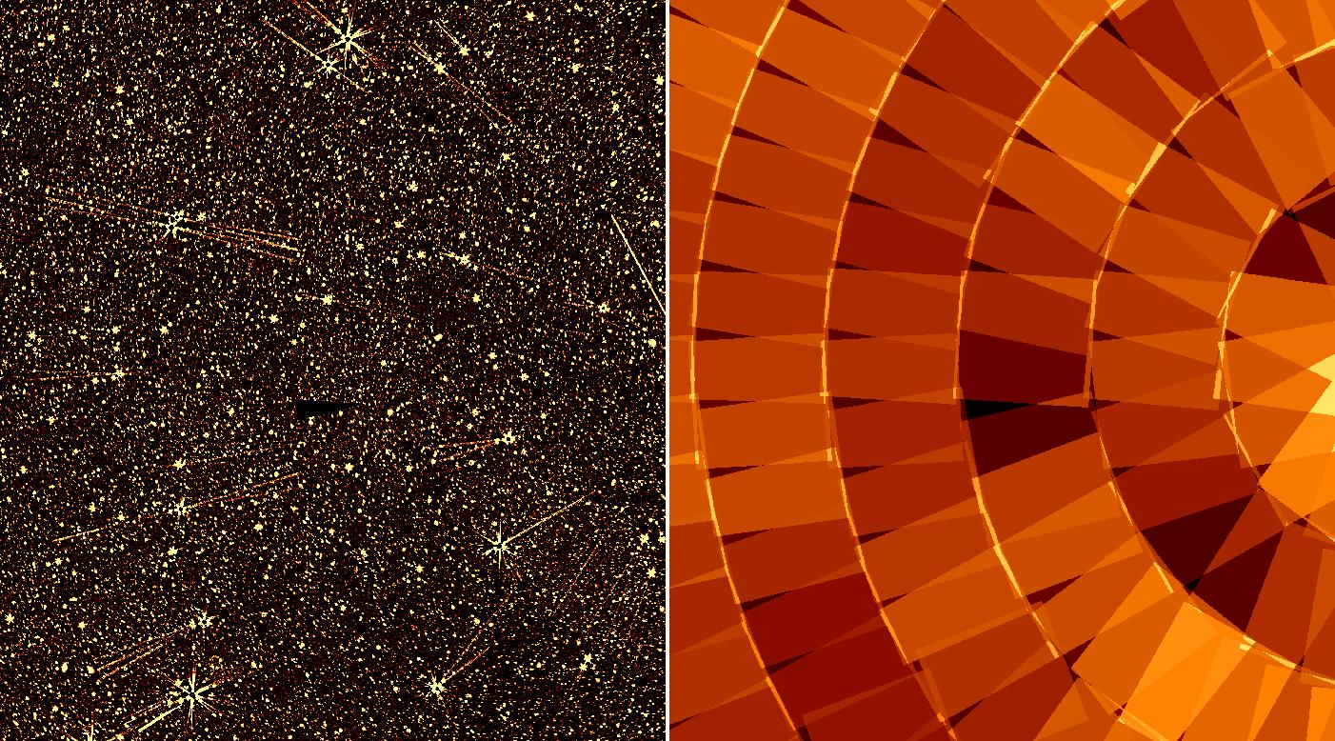
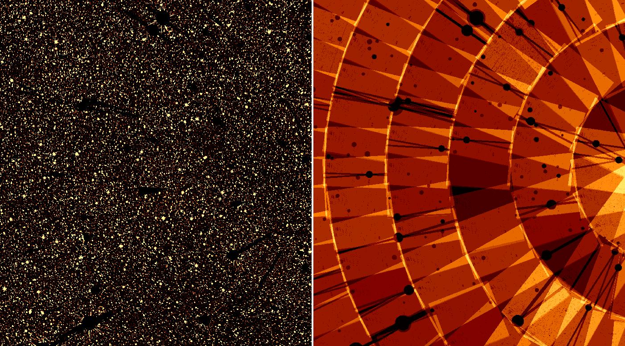
Final Mosaic of N4

Slide 28
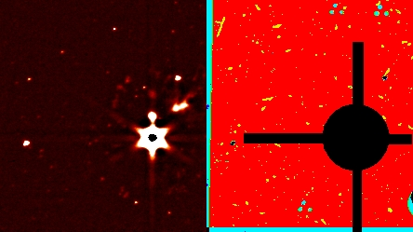
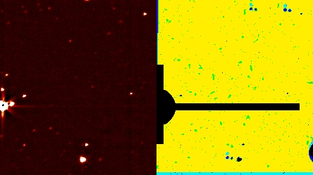
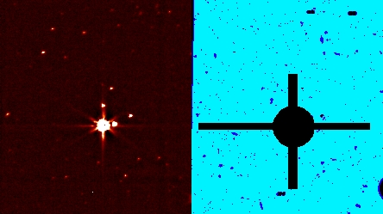
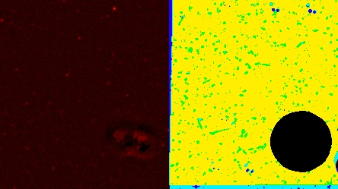
Region masking of MIR
We masked most of the bright stars manually one by one !
Representative Cases

Slide 29
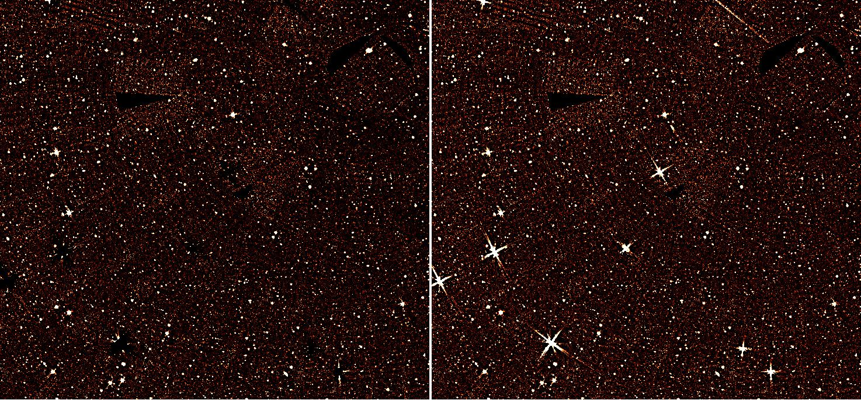
Final Mosaic of S7
We removed the influence from bad data and the bright stars !
after vs before this work

Slide 30
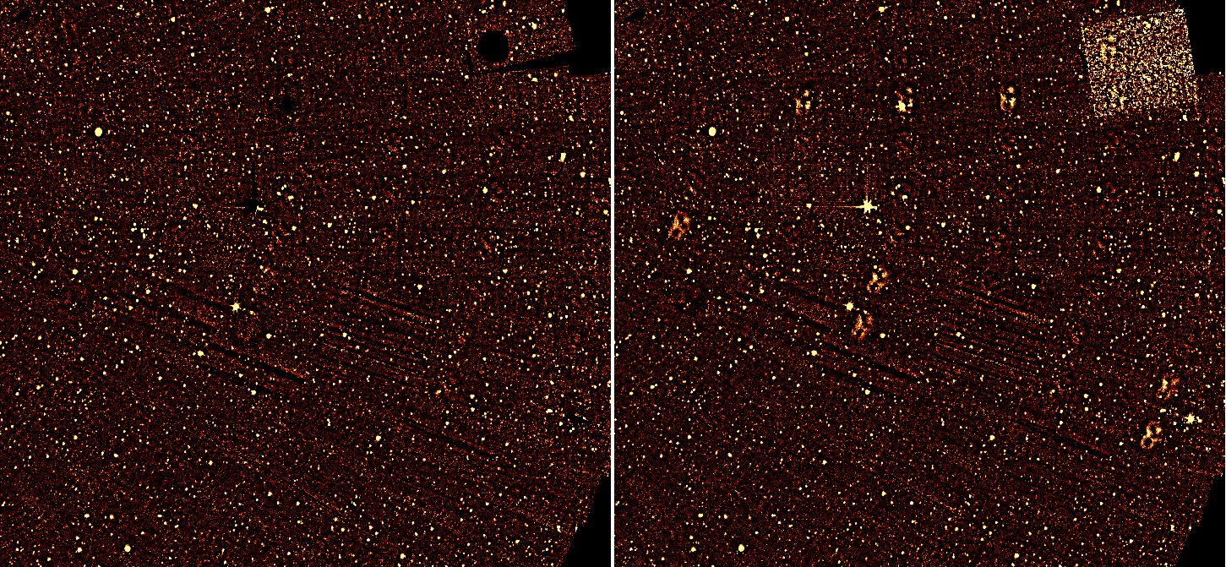
Final Mosaic of S9W
We removed the influence from bad data, the bright stars & bean-pattern, too !
after vs before this work

Slide 31
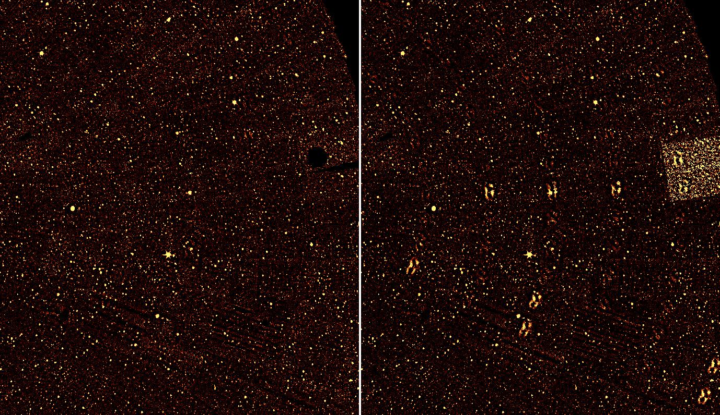
Final Mosaic of S11
We removed the influence from bad data, the bright stars & bean-pattern, too !
after vs before this work

Slide 32
Confirmation of sources with optical images
We have optical imaging data with CFHT (inner 2 sq. deg.) and Maidanak
CFHT field: u*,g’,r’,i’,z’ (Hwang et al. 2007)
Maidanak field: B, R, I filters (Jeon et al. 2010)
Near IR sources are likely to have optical counterparts
Optical images help us to decide the type of the sources (point/extended)
The SED over wide range of λ is important to explore the nature of sources.

Slide 33
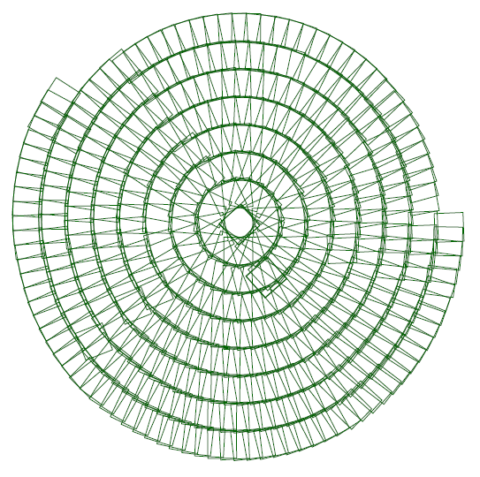
NIR vs Optical
CFHT field
Maidanak field
Sources located
inside red boundary
Sources in
blue boundary
27,181 (87%)
N2 : 31,000
N2 : 62,000
50,431 (81%)
30,111 (81.7%)
N3 : 36,000
N3 : 74,000
51,954 (70.3%)
26,329 (77.4%)
N4 : 34,000
N4 : 68,000
45,604 (67%)
Number of
matched sources
to CFHT catalogue
Number of
matched sources
to Maid. catalogue
optical observation for each field

Slide 34
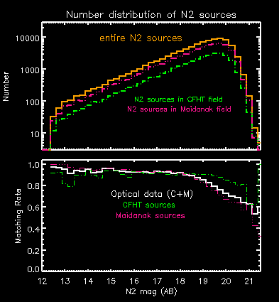
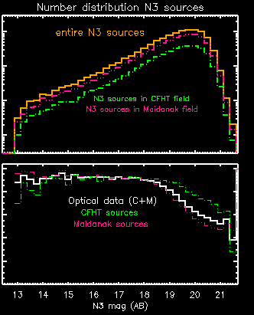
NIR vs Optical

Slide 35
MIR vs Optical
CFHT field
Maidanak field
Sources located
inside red boundary
Sources in
blue boundary
4,639
( 89.1%)
S7 : 5,209
S7 :11,500
10,280
( 89.4%)
5,616
( 87.8%)
S9W : 6,400
S9W : 13,420
12,187
(90%)
4,551
( 86.1%)
S11 : 5,285
S11 : 11,260
9,736
(86.4 %)
3,183
(72.6%)
L15 : 4,385
L15 : 9,530
6,014
( 63.1%)
3,414
(68.6%)
L18W: 3,414
L18W : 11,094
6,388
(57.6%)
Number of
matched sources
to CFHT catalogue
Number of
matched sources
to Maid. catalogue
optical observation for each field

Slide 36


MIR(S) vs Optical

Slide 37
Final Catalogue
Final catalogues should contain reliable astronomical sources
We used ground based J & H data from KPNO (Jeon et al.), and other AKARI band data for further confirmation of the sources

Slide 38
NIR bands
positional cross-matching
Matching radius
updated N2
87,858
updated N3
104,170
updated N4
96,159
1,534
(1.7%)
3,375
(3.2%)
6,384
(6.5%)
θ = 3.0″
o p t i c a l d a t a ( CFHT + Maidanak )
other data
used for
matching test
K P N O J , H d a t a
N3 , N4
N2 , N4
N2 , N3
S7
# of sources
not matched
even once

Slide 39



inter-NIR matching
color
blue : N2
green : N3
orange : N4
ellipse : matched sources
box : unmatched remaining
arrow : matching direction

Slide 40


Slide 41
MIR-S bands
positional cross-matching
Matching radius
updated S7
15,390
updated S9W
18,772
updated S11
15,680
362
(2.35%)
408
(2.17%)
640
(4.08%)
N2
N2
N2
θ = 3.0″
N3
N3
N3
N4
N4
N4
other bands used for
matching test
S9W
S7
S7
S11
S11
S9W
L15
L15
L15
# of sources
not matched
even once
L18W
L18W
L18W

Slide 42
Summary
Maidanak optical imaging data provided useful tool for the confirmation of NEP-Wide IR sources.
NEP-Wide NIR/MIR catalogue is almost ready (~100,000 sources/5.8 sq. deg.)
Maidanak and CFHT used different filters, and less sensitivity than CFHT
Maidanak observation was carried out before cleaning of the mirror:
  Carry out new survey with SDSS filter set?
  It will take large amount of observing time.

